Slide 1
ATAC-seq data analysis handbook
Chengchen ZHAO, Zheting ZHANG, Yawen LYU, Wei SHI, Tianci KONG, Tiancheng Yu, Yuxiang YAO
2025.3.20

Slide 2
ATAC progress
Experiment Overview (Yawen)
Pre-process Pipeline (Wei)
Downstream Analysis
Quality control (Zejie)
Dynamic pattern analysis (Tianci & Wei)
Motif analysis (Tianci)
Accessibility in selected regions (Tiancheng)
Visualization in IGV (Jingyu)
Correlation analysis (Zheting)
Tricks
Extension & Limitation

Slide 3
Experiment Overview
ATAC-seq
ATAC-seq (Assay for Transposase-Accessible Chromatin with high-throughput sequencing) is a technique developed in 2013 by William J. Greenleaf and Howard Y. Chang’s labs at Stanford University to study chromatin accessibility—the openness of chromatin to regulatory proteins like transcription factors.
In eukaryotic cells, DNA wraps around histone proteins to form nucleosomes, creating a "beads-on-a-string" structure. These structures further fold into compact chromatin with the help of proteins like CTCF and cohesin, allowing long DNA strands to fit within the nucleus.
Gene expression requires certain chromatin regions, such as promoters and enhancers, to become accessible. This local chromatin opening is regulated by epigenetic modifications, notably histone acetylation, and forms what’s known as open chromatin. These accessible regions enable transcription factors to bind, making chromatin accessibility a key indicator of transcriptional regulation.
Credit : Yawen Lyu
Notes:
ATAC-seq，全称Assay for Transposase-Accessible Chromatin with high throughput sequencing，是2013年由斯坦福大学William J. Greenleaf和Howard Y. Chang实验室开发的用来研究染色质可及性的方法。
要理解这项技术的原理，首先要知道染色体/质的结构。真核生物的核DNA并不是裸露的，而是组蛋白与之结合。DNA一圈一圈地缠绕在8个组蛋白上，形成核小体，每个核小体占了约147bp的DNA。一个个核小体构成了串珠样的结构，然后进一步折叠、聚合，并在其他架构蛋白的协助下，形成染色体。这样就能将超长的DNA链，折叠成很小很小的结构，塞进小小的细胞核里。

Slide 4
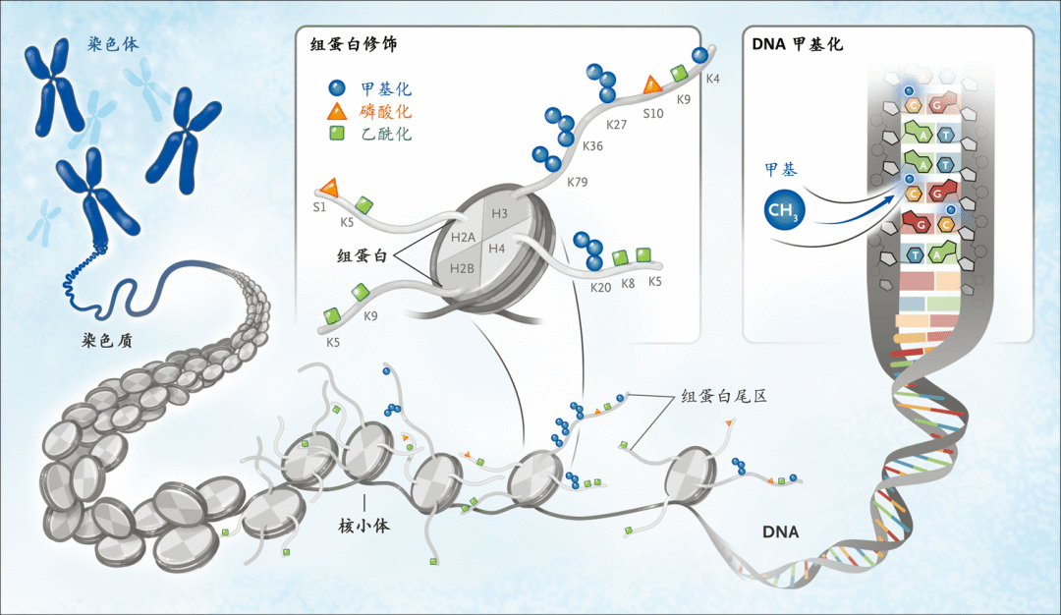
Experiment Overview
Chromatin accessibility is closely linked to transcriptional regulation and plays a crucial role in cell fate determination and disease mechanisms. ATAC-seq leverages this principle by using a hyperactive Tn5 transposase to insert sequencing adapters into open regions of the chromatin. These regions are then selectively enriched and sequenced, allowing researchers to map genome-wide patterns of chromatin accessibility.
Bates S E . et al. New England Journal of Medicine, 2020
Credit : Yawen Lyu

Slide 5
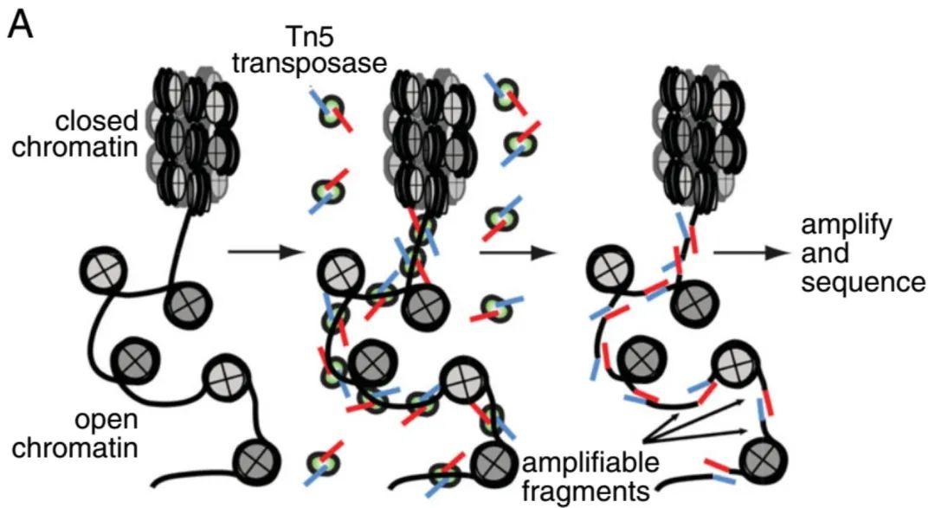
Experiment Overview
How does ATAC-seq identify open chromatin regions?
The technique leverages a transposase enzyme called Tn5, which naturally inserts DNA sequences into the genome through a “cut-and-paste” mechanism. However, this insertion can only occur in regions where the chromatin is open—dense chromatin structure prevents the enzyme from accessing tightly packed DNA.
In ATAC-seq, Tn5 is pre-loaded with sequencing adapters. When introduced into the nucleus, the Tn5 enzyme preferentially inserts these adapters into accessible (open) chromatin regions by cutting the DNA at those sites. After cell lysis and DNA fragmentation, high-throughput sequencing is performed using the known adapter sequences. The resulting reads indicate which regions of the genome were accessible at the time of the experiment.
Buenrostro JD.et al, Nat Methods, 2015
Credit : Yawen Lyu

Slide 6
Experiment Overview
What’s the difference between ATAC-seq and ChIP-seq?
ChIP-seq is a targeted approach used when you already have a specific transcription factor of interest. It uses antibodies against that factor to pull down DNA fragments it binds to, allowing you to verify protein-DNA interactions.
In contrast, ATAC-seq is an unbiased, genome-wide method that identifies regions of open chromatin without focusing on any particular transcription factor. It reveals potential binding sites for regulatory proteins across the genome. When combined with other methods, ATAC-seq can help identify candidate transcription factors involved in gene regulation.
Credit : Yawen Lyu
Notes:
ChIP-Seq是实验前明确有一个感兴趣的转录因子，根据目标转录因子设计抗体去做ChIP实验拉DNA，验证感兴趣的转录因子是否与DNA存在相互作用；
而ATAC-Seq没有落脚到具体哪个转录因子，是在全基因组范围内检测染色质的开放程度，可以得到全基因组范围内的蛋白质可能结合的位点信息，用这个技术方法与其他方法结合是想去筛感兴趣的调控因子。

Slide 7
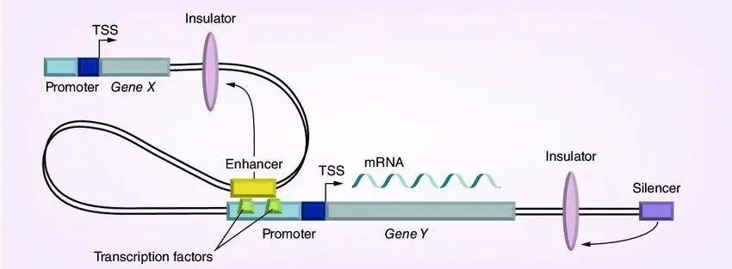
Experiment Overview
What are common regions of open chromatin?
Open chromatin regions are typically found in promoters and distal regulatory elements such as enhancers and silencers. Promoters are DNA regions near the transcription start site (TSS) that contain transcription factor binding sites (TFBS). Transcription factors bind to these sites to recruit RNA polymerase and initiate transcription.Enhancers are located up to 1 Mb upstream or downstream of the promoter. When transcription factors bind to enhancers and physically interact with the promoter region, they enhance gene expression. In contrast, silencers reduce or suppress gene transcription.
ATAC-seq can identify open chromatin regions such as promoters, enhancers, silencers, and transcription factor binding sites. While gene bodies can also show chromatin accessibility, this is usually transient—chromatin opens briefly during transcription and quickly returns to a closed state.
Luizon, et al,Pharmacogenomics, 2015
Credit : Yawen Lyu
Notes:
常见的染色质开放区主要是基因上游的启动子和远端的调控元件比如增强子和沉默子，启动子是靠近转录起始点(TSS)的DNA区域，它包含转录因子的结合位点（transcription factor binding site，TFBS），所以转录因子能够结合在启动子上TFBS，招募RNA聚合酶进而转录基因。增强子一般位于启动子下游或上游1Mb的DNA区域，转录因子与增强子结合，并与启动子区域接触时，能够促进基因的转录。相反，沉默子会减少或抑制基因的表达。
所以说，ATAC-seq可以帮助识别启动子区域、潜在的增强子或沉默子，也就是说，ATAC-seq中的peak，往往是启动子、增强子序列，以及一些反式调控因子结合的位点。 基因的body虽然是染色质开放区，但是基因body区的染色质开放并不是稳定的，当进行转录时，body区域每往前走一步，开放后进行转录，转录后迅速回复原有状态。

Slide 8
Experiment Overview
What can ATAC-seq be used for?
Identifying key transcription factors
Mapping transcription factor binding sites (footprinting)
Generating epigenomic landscapes
Detecting chromatin accessibility across different tissues or conditions
Determining nucleosome positioning
https://zhuanlan.zhihu.com/p/512163334
Credit : Yawen Lyu
Notes:
鉴定重要转录因子
生成转录因子结合区域的特征(footprinting)
生成表观基因组图谱
得到在不同组织或不同条件下对应可及性区域
得到核小体位置

Slide 9
Pre-process Pipeline
Step1 Adapter Trimming
# bash
trim_galore --gzip -j ${THREAD} --paired ${R1_FILE_NMAE} ${R2_FILE_NMAE} --trim-n -o ${temp_path} --no_report_file --basename ${SAMPLE_PREFIX}
--gzip | The processed FastQ files are output in gzipped format (.gz)
-j | Number of CPU threads
--paired | Specifies paired-end sequencing files (R1 and R2) as input
--trim-n | Removes N bases from read termini
-o | Specifies the output directory for trimmed files
--no_report_file | Disables generation of default QC reports
--basename | Specifies filename prefix for output files
Trim Galore automatically trims adapter sequences (e.g., Illumina adapters) and low-quality bases.
Step2 mapping
# bash
bowtie2 -q -p ${THREAD} -x ${mapping_index} -1 ${temp_path}/${SAMPLE_PREFIX}_val_1.fq.gz -2 ${temp_path}/${SAMPLE_PREFIX}_val_2.fq.gz -S ${bam_path}/${SAMPLE_PREFIX}.align.sam
samtools view -@ ${THREAD} -bS ${bam_path}/${SAMPLE_PREFIX}.align.sam > ${bam_path}/${SAMPLE_PREFIX}.bam
samtools sort -@ ${THREAD} ${bam_path}/${SAMPLE_PREFIX}.bam > ${bam_path}/${SAMPLE_PREFIX}.Sorted.bam
-q | Specifies that input files are FASTQ format with Phred quality scores
-p | Number of CPU threads
-x | Prefix/path of the Bowtie2 pre-built reference genome index
-1 | Path to first paired-end FASTQ file
-2 | Path to second paired-end FASTQ file
-S | File to write SAM format alignment output
Accurately locate the short reads obtained from sequencing onto the reference genome.
Credit : Wei Shi

Slide 10
Pre-process Pipeline
Step3 Count the reads of different chromosomes
# bash
samtools view -@ ${THREAD} ${bam_path}/${SAMPLE_PREFIX}.bam | awk '/^[^#]/ {print $3}' | sort | uniq -c | sort -k1,1rg | awk 'BEGIN{print "chromosome\tnumber"} {print $2"\t"$1}' > ${qc_path}/${SAMPLE_PREFIX}.ChromosomeDistribution.txt
samtools view -@ ${THREAD} -f 0x2 ${bam_path}/${SAMPLE_PREFIX}.bam | awk 'NR % 2 == 1{mapq=$5;forward=$0} NR % 2 == 0{if($5>=30 && mapq>=30 && substr($3,1,3)=="chr" && $3 !~ /_/) print $3}' | sort | uniq -c | sort -k1,1rg | awk 'BEGIN{print "chromosome\tnumber"} {print $2"\t"$1}' > ${qc_path}/${SAMPLE_PREFIX}.Filtered.ChromosomeDistribution.txt
ChromosomeDistribution. txt stores the distribution of all successfully aligned reads on each chromosome
Filtered.ChromosomeDistribution.txt stores the distribution of high-quality, correctly paired reads on standard chromosomes (such as chr1-22, chrX, chrY), excluding low-quality and unconventional chromosomes.
-f 0x2 | Only retain correctly paired reads (reads in paired end data that are aligned at both ends and oriented correctly)
substr($3,1,3)=="chr" && $3 !~ /_/ | Keep only regular chromosomes
$5>=30 && mapq>=30 | The MAPQ of the current read and paired read is ≥ 30
Step4 Filter reads
# bash
# Extract header information from BAM files
samtools view -@ ${THREAD} -H ${bam_path}/${SAMPLE_PREFIX}.bam > ${bam_path}/${SAMPLE_PREFIX}.Filtered.sam
# Filter high-quality paired reads and append them to the SAM file
samtools view -@ ${THREAD} -f 0x2 ${bam_path}/${SAMPLE_PREFIX}.bam | awk 'NR % 2 == 1{mapq=$5;forward=$0} NR % 2 == 0{if($5>=30 && mapq>=30 && substr($3,1,3)=="chr" && $3!="chrM" && $3 !~ /_/) print forward"\n"$0}' >> ${bam_path}/${SAMPLE_PREFIX}.Filtered.sam
# Convert SAM to BAM format
samtools view -@ ${THREAD} -bS ${bam_path}/${SAMPLE_PREFIX}.Filtered.sam > ${bam_path}/${SAMPLE_PREFIX}.Filtered.bam
Extract high-quality, correctly paired reads from the original BAM file
Credit : Wei Shi

Slide 11
Pre-process Pipeline
Step5 生成BW文件
# bash
# Convert BAM files to BED files，retain raw data
bamToBed -i ${bam_path}/${SAMPLE_PREFIX}.Filtered.bam > ${bed_path}/${SAMPLE_PREFIX}.RawReads.bed
# Sort BAM files by name
samtools sort -n -@ 20 ${bam_path}/${SAMPLE_PREFIX}.Filtered.bam > ${bam_path}/${SAMPLE_PREFIX}.FilteredSorted.bam
# Convert sorted BAM files to BEDPE format
bamToBed -bedpe -i ${bam_path}/${SAMPLE_PREFIX}.FilteredSorted.bam | awk '$1==$4 && $2>0 && $5>0 {print $1"\t"$2"\t"$6}' | sort -k1,1 -k2,2n | uniq | grep -v WARNING > ${bed_path}/${SAMPLE_PREFIX}.Fragments.bed
# Calculate segment length distribution
awk '{print $3-$2}' ${bed_path}/${SAMPLE_PREFIX}.Fragments.bed | sort | uniq -c | sort -k2,2g | awk 'BEGIN{print "fragment_length\tnumber"} {print $2"\t"$1}' > ${qc_path}/${SAMPLE_PREFIX}.FragmentsLength.txt
# Sort BED files by chromosome and starting position
bedSort ${bed_path}/${SAMPLE_PREFIX}.Fragments.bed ${bed_path}/${SAMPLE_PREFIX}.bed
# Calculate the number of read segments and scaling factor
n=`wc -l ${bed_path}/${SAMPLE_PREFIX}.bed | cut -f 1 -d " "`
c=`bc -l <<< "1000000 / $n"`
# Use the genomeCoverageBed tool to calculate genome coverage and generate a bedGraph file (bdg)
genomeCoverageBed -bga -scale $c -i ${bed_path}/${SAMPLE_PREFIX}.bed -g ${chromInfo} > ${temp_path}/${SAMPLE_PREFIX}.bdg > ${log_path}/${SAMPLE_PREFIX}.Createbdg.log 2>&1
# Use the bedClip tool to crop the bedGraph file, ensuring that all regions are within the range of the chromosome
bedClip ${temp_path}/${SAMPLE_PREFIX}.bdg ${chromInfo} ${temp_path}/${SAMPLE_PREFIX}.Clip.bdg
# Sort bedGraph files by chromosome and starting position
bedSort ${temp_path}/${SAMPLE_PREFIX}.Clip.bdg ${temp_path}/${SAMPLE_PREFIX}.bdg.temp
# Use the bedGraphToBigWig tool to convert bedGraph files to bigWig files (bw)
bedGraphToBigWig ${temp_path}/${SAMPLE_PREFIX}.bdg.temp ${chromInfo} ${bw_path}/${SAMPLE_PREFIX}.bw
1. Convert BAM files to BEDGraph files using the genomeCoverageBed tool
2. Use the scale option of genomeCoverageBed tool to apply scaling factors and normalize coverage to coverage per million reads
3. Convert normalized BEDGraph files to BigWig files using the bedGraphToBigWig tool
Credit : Wei Shi

Slide 12
Pre-process Pipeline
Step6 Generate Bigbed file
# bash
bedToBigBed ${bed_path}/${SAMPLE_PREFIX}.bed ${chromInfo} ${bed_path}/${SAMPLE_PREFIX}.bb
BigBed file is an efficient binary file format used for storing and visualizing genome annotation data, which can be efficiently stored and queried, and is particularly suitable for use in genome browsers.
Step7 Call peak
# bash
macs14 -t ${bed_path}/${SAMPLE_PREFIX}.bed -n ${peak_path}/${SAMPLE_PREFIX}_e3 -f BED -g ${species} --keep-dup all --nomodel --shiftsize 25 -p 1e-3 > ${log_path}/${SAMPLE_PREFIX}_e3.PeakCalling.log 2>&1
macs14 -t ${bed_path}/${SAMPLE_PREFIX}.bed -n ${peak_path}/${SAMPLE_PREFIX}_e5 -f BED -g ${species} --keep-dup all --nomodel --shiftsize 25 -p 1e-5 > ${log_path}/${SAMPLE_PREFIX}_e5.PeakCalling.log 2>&1
macs14 -t ${bed_path}/${SAMPLE_PREFIX}.bed -n ${peak_path}/${SAMPLE_PREFIX}_e7 -f BED -g ${species} --keep-dup all --nomodel --shiftsize 25 -p 1e-7 > ${log_path}/${SAMPLE_PREFIX}_e7.PeakCalling.log 2>&1
-t | Specify the path of the input BED file
-n | Specify the prefix of the output file
-f | Specify the format of the input file
-g | Specify the type of genome
--keep-dup all | Keep all duplicate reading segments
--nomodel | Do not use models to estimate segment length
--shiftsize | Specify the displacement for each reading segment
-p | Specify the threshold for significance level
MACS1.4 identifies protein binding sites in ATAC seq data by establishing statistical models.
It considers factors such as fragment length, displacement adjustment, background noise, etc., evaluates the significance of each region by calculating p-values, and calls peaks based on a set threshold.
Credit : Wei Shi

Slide 13
Pre-process Pipeline
Step8 Get Promoter Signal
# bash
python3 /mnt/shiwei/bin/GetBigwigSignal.py ${promoter_file} ${bw_path}/${SAMPLE_PREFIX}.bw ${temp_path}/${SAMPLE_PREFIX}.PromoterSignal.tmp 1
cut -f 5 ${promoter_file} | paste - ${temp_path}/${SAMPLE_PREFIX}.PromoterSignal.tmp > ${temp_path}/${SAMPLE_PREFIX}.PromoterSignal.tmp2
python3 /usr/local/bin/GeneSymbolUniq.py ${temp_path}/${SAMPLE_PREFIX}.PromoterSignal.tmp2 ${signal_path}/${SAMPLE_PREFIX}.PromoterSignal 0
1. Use the GetBigwigSignal.py script to extract the signal values for each boot subregion from the BigWig file and save them to a temporary file.
2. Extract gene names from the promoter file using the cut and paste commands, and merge the gene names with the signal values.
3. Use the GeneSymbolUniq.py script to process the merged file, remove duplicates, and generate the final boot signal file.
Credit : Wei Shi

Slide 14
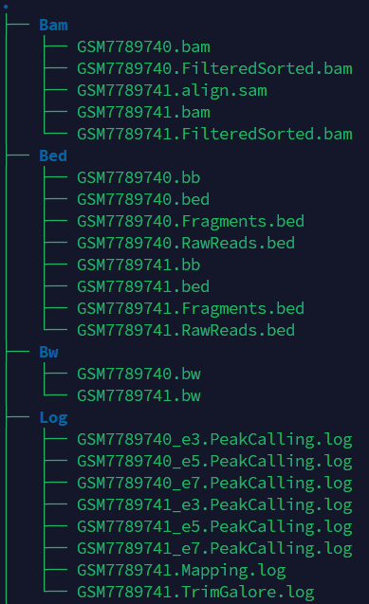
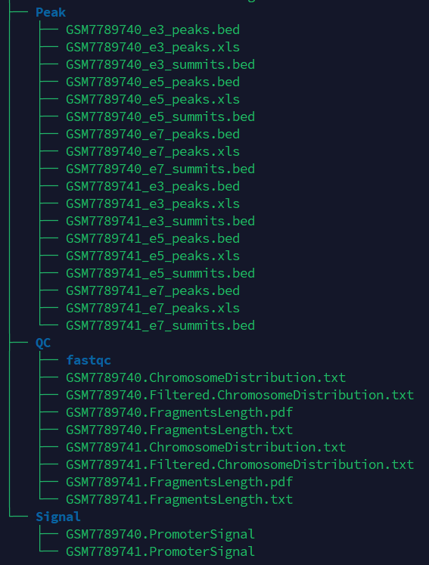
Pre-process
- Preprocess
Tools：CDesk
Input command line:
CDesk ATAC preprocess \
-i /mnt/linzejie/CDesk_test/data/3.ATAC/1.preprocess/bam_fq \
-o /mnt/linzejie/CDesk_test/result/3.ATAC/1.preprocess/bam_fq \
-t 100 --fastqc -s mm10 \
--group /mnt/linzejie/CDesk_test/data/3.ATAC/1.preprocess/group.csv
Typical Parameter:
参数（√必须参数） | 描述 | 默认值
-i√ | 存放输入fastq.gz/fq.gz/bam文件的位置 | -
-o√ | 输出结果文件夹 | -
-s√ | 比对基因组物种选择 | mm10,rn7,hg38,susScr11,galGal6
-t | 指定线程数 | 8
-l | 单端测序（1），双端测序（2） | 2
--fastqc | 是否进行fastqc质控
--group | 分组信息，用来合并重复和重命名bam文件

Slide 15
Pre-process Pipeline
测序数据量=目标区域大小×测序深度
1
Raw data vs. Clean data？

Slide 16
Quality control
QC of sequencing
QC of library construction
Fragment length distribution
Replicates correlation

Slide 17
Quality control
- QC of sequencing
1. Adapter removal
# bash
trim_galore --gzip -j 4 --paired ${data_path}/${fastq_file_arr[0]} ${data_path}/${fastq_file_arr[1]} --trim-n -o ${result_path} --no_report_file --basename ${out_name} > ${log_path}/${out_name}/${out_name}.TrimGalore.log
Remove the N-base at the end of the sequence
Automatically detects and removes common Illumina adapters
2. Alignment Filter
# bash
samtools view -@ ${THREAD} -F 0x400 ${bam_path}/${SAMPLE_PREFIX}.bam | awk 'NR % 2 == 1{mapq=$5;forward=$0} NR % 2 == 0{if($5>=30 && mapq>=30 && substr($3,1,3)=="chr" && $3!="chrM" && $3 !~ /_/) print forward"\n"$0}' >> ${bam_path}/${SAMPLE_PREFIX}.Filtered.sam
samtools view -@ ${THREAD} -f 0x2 ${bam_path}/${SAMPLE_PREFIX}.bam | awk 'NR % 2 == 1{mapq=$5;forward=$0} NR % 2 == 0{if($5>=30 && mapq>=30 && substr($3,1,3)=="chr" && $3!="chrM" && $3 !~ /_/) print forward"\n"$0}' >> ${bam_path}/${SAMPLE_PREFIX}.Filtered.sam
- Remove Mitochondrial reads
- Keep high quality (paired) reads
- Remove duplicate bed files
# bash
awk '{print $3-$2}' ${bed_path}/${SAMPLE_PREFIX}.Fragments.bed | sort | uniq -c | sort -k2,2g | awk 'BEGIN{print "fragment_length\tnumber"} {print $2"\t"$1}' > ${qc_path}/${SAMPLE_PREFIX}.FragmentsLength.txt
Credit : Zejie Lin

Slide 18
Quality control
- QC of sequencing
1. FastQC / MultiQC
It is generally a good idea to generate some quality metrics for your raw sequence data.
# bash
fastqc <sample>.fastq.gz
multiqc <analysis_directory>
Output: FastQC html report
2. Adapter removal
# bash
trim_galore --gzip -j 4 --paired ${data_path}/${fastq_file_arr[0]} ${data_path}/${fastq_file_arr[1]} --trim-n -o ${result_path} --no_report_file --basename ${out_name} > ${log_path}/${out_name}/${out_name}.TrimGalore.log
Remove the N-base at the end of the sequence
Automatically detects and removes common Illumina adapters
Credit : Zejie Lin

Slide 19
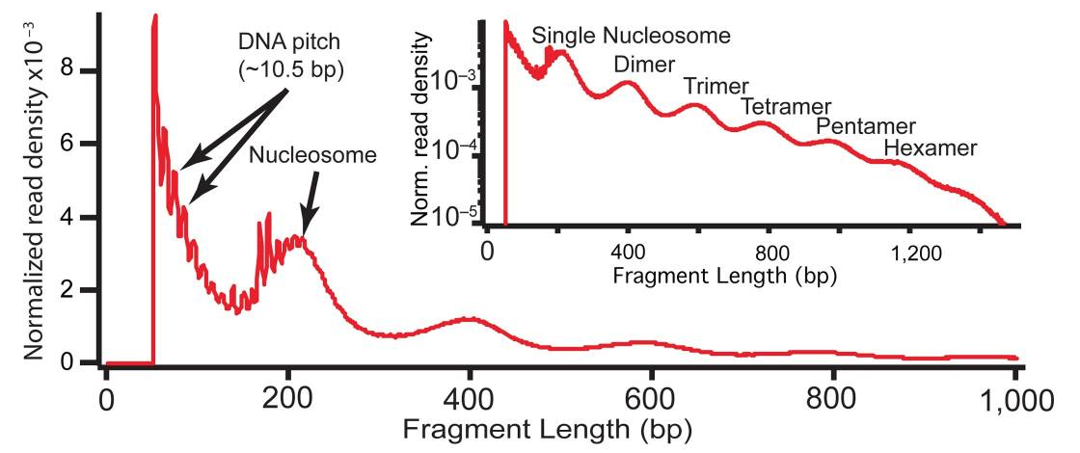
Quality control
- QC of library constuction
Fragment length distribution
# bash
bamToBed -bedpe -i $sample}.bam | awk '{print $1"\t"$2"\t"$6}' | sort -k1,1 -k2,2n | uniq > ${sample}_fragments.bed
awk '{print $3-$2}' ${sample}_fragments.bed | sort | uniq -c | sort -k2,2g | awk 'BEGIN{print "fragment_length\tnumber"} {print $2"\t"$1}' > <sample>.FragmentsLength.txt
Rscript FragmentLengthDistribution.R <sample>.FragmentsLength.txt
Buenrostro, J., Giresi, P., Zaba, L. et al. Transposition of native chromatin for fast and sensitive epigenomic profiling of open chromatin, DNA-binding proteins and nucleosome position. Nat Methods 10, 1213–1218 (2013).
Credit : Zejie Lin

Slide 20
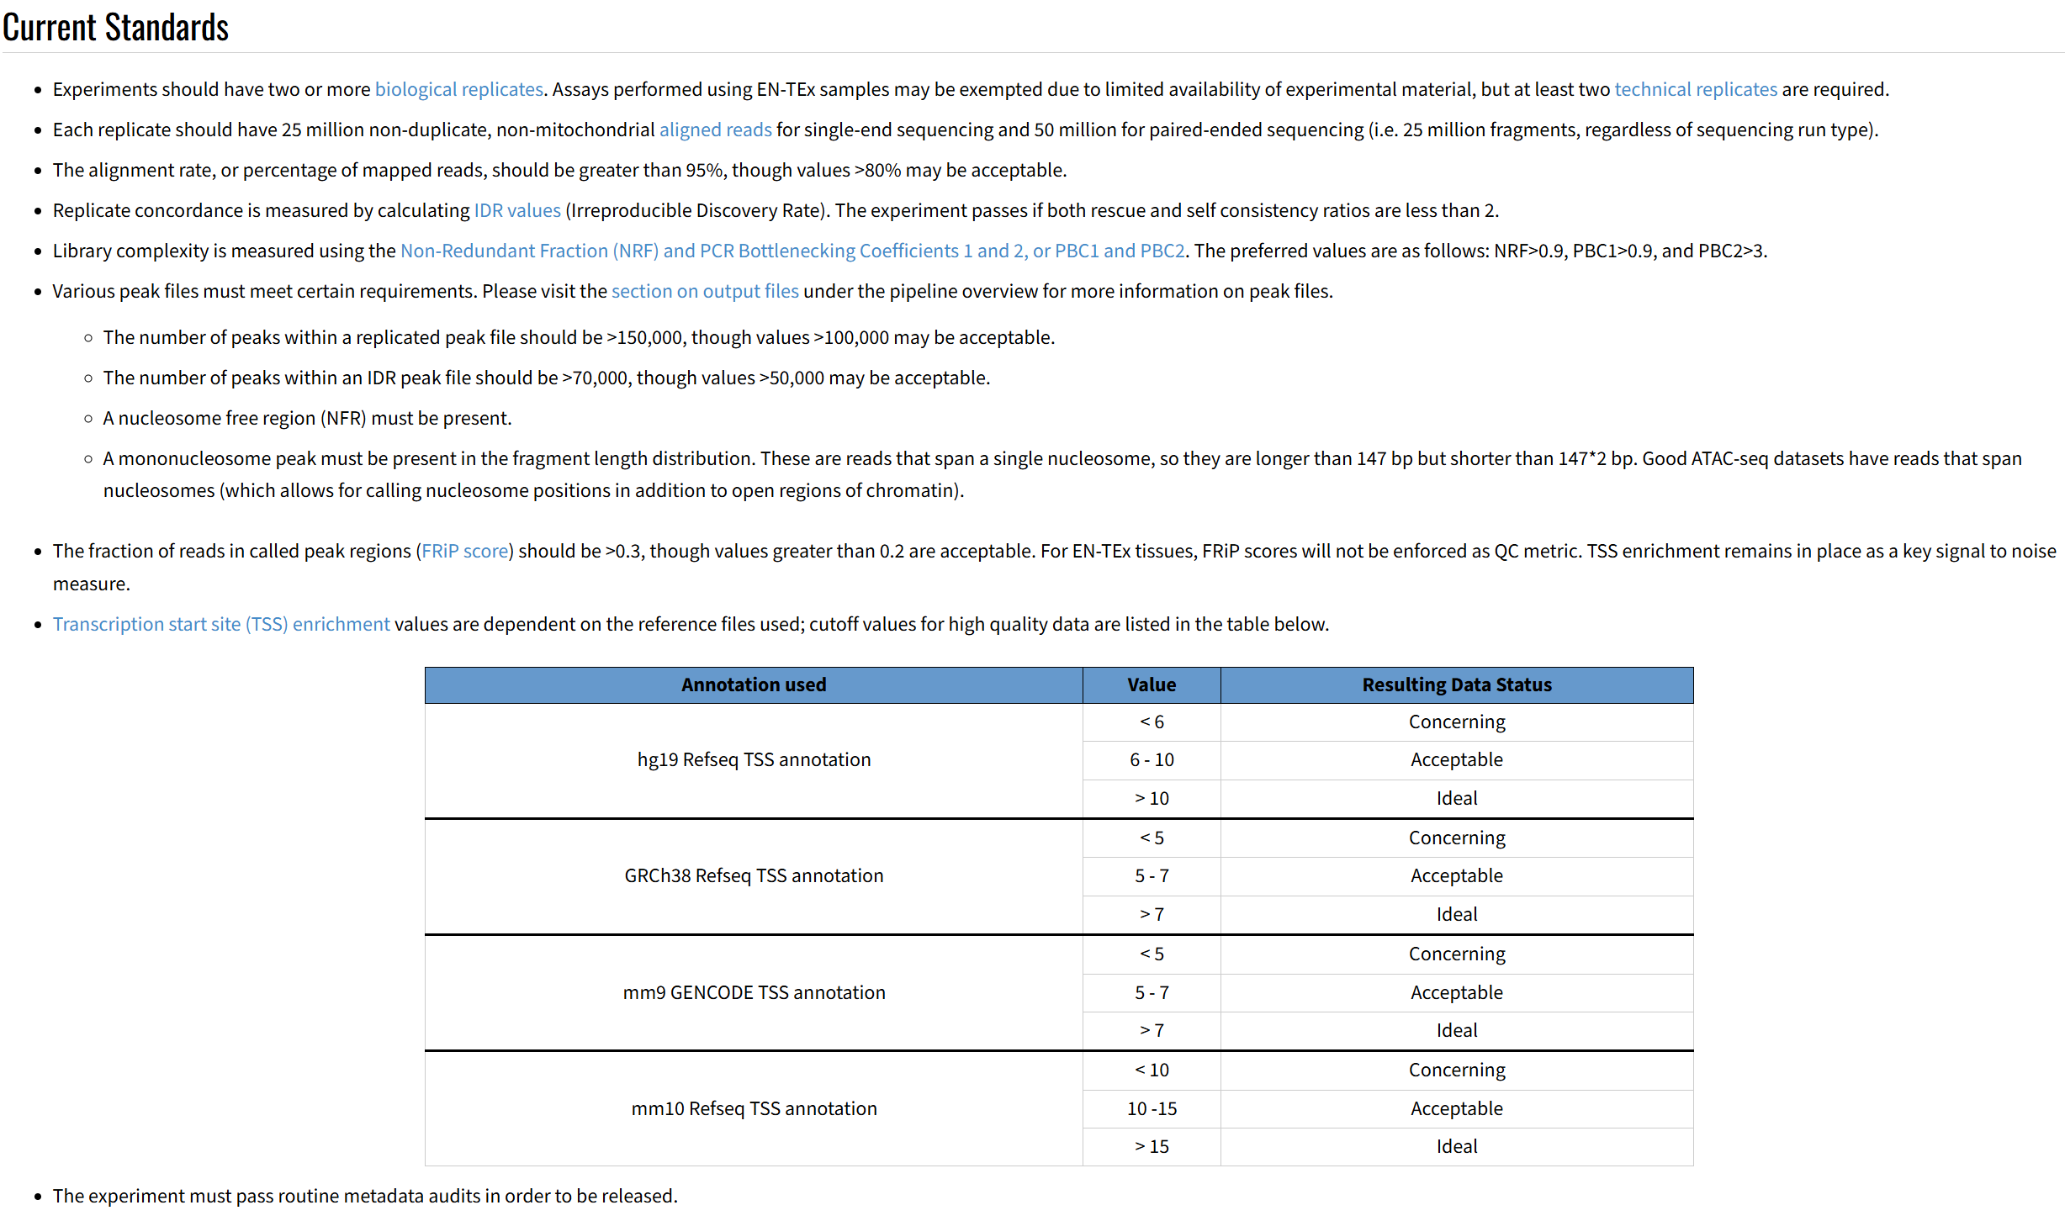
Quality control
ENCODE - ATAC-seq Data Standards
Credit : Zejie Lin
https://www.encodeproject.org/atac-seq/

Slide 21
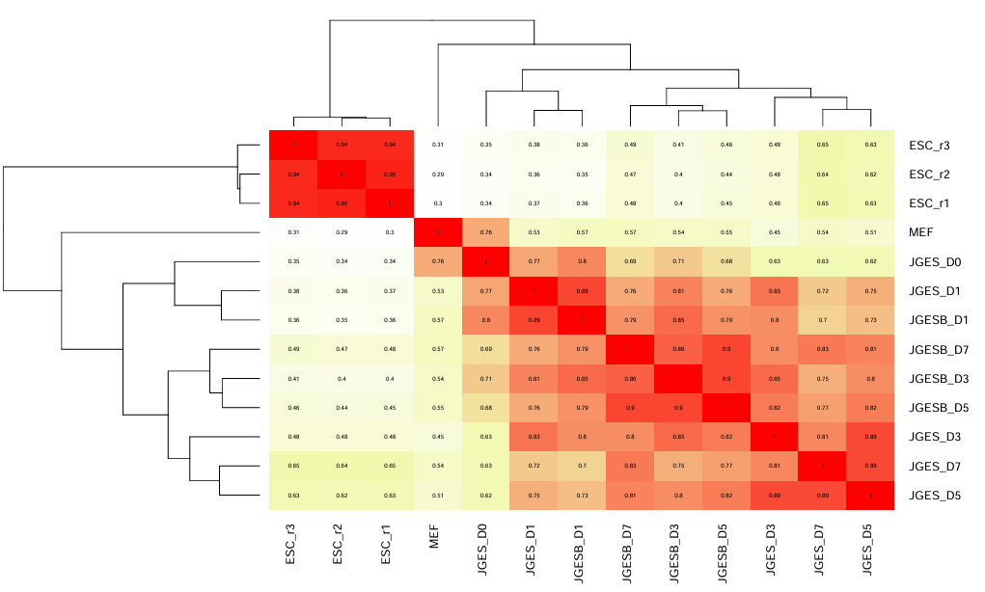
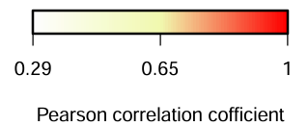
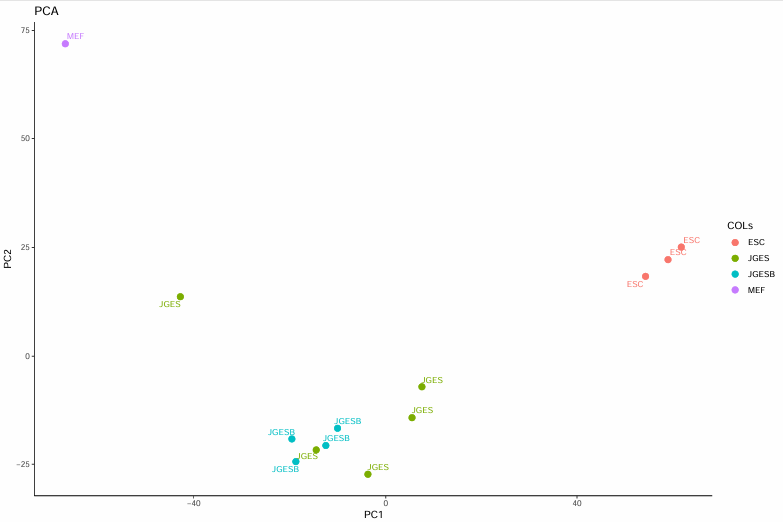
Quality control
- Replicates correlation(QC)
Tools：CDesk
Input command line:
CDesk ATAC QC --bw /mnt/linzejie/CDesk_test/data/3.ATAC/2.QC/bw \
--peak /mnt/linzejie/CDesk_test/data/3.ATAC/2.QC/peak \
--group /mnt/linzejie/CDesk_test/data/3.ATAC/2.QC/meta.csv \
--bin 500 --step 1 -o /mnt/linzejie/CDesk_test/result/3.ATAC/2.QC -t 100 \
--suffix _peaks.bed --species mm10
Typical Parameter:
参数 | 描述 | 默认值
--bw√ | bw文件文件夹 | -
-o√ | 输出结果存放位置 | -
--group√ | 分组相关信息文件 | -
--species√ | 物种 | mm10,rn7,hg38,susScr11,galGal6
--peak | 峰值bed文件文件夹
--bin | 基因切分长度 | 500
--suffix | 选择的峰bed文件后缀 | _peaks.bed
--step | 峰值计算长度 | 1
-t | 指定线程数 | 30
--height | 画图高度 | 8
--width | 画图宽度 | 12

Slide 22
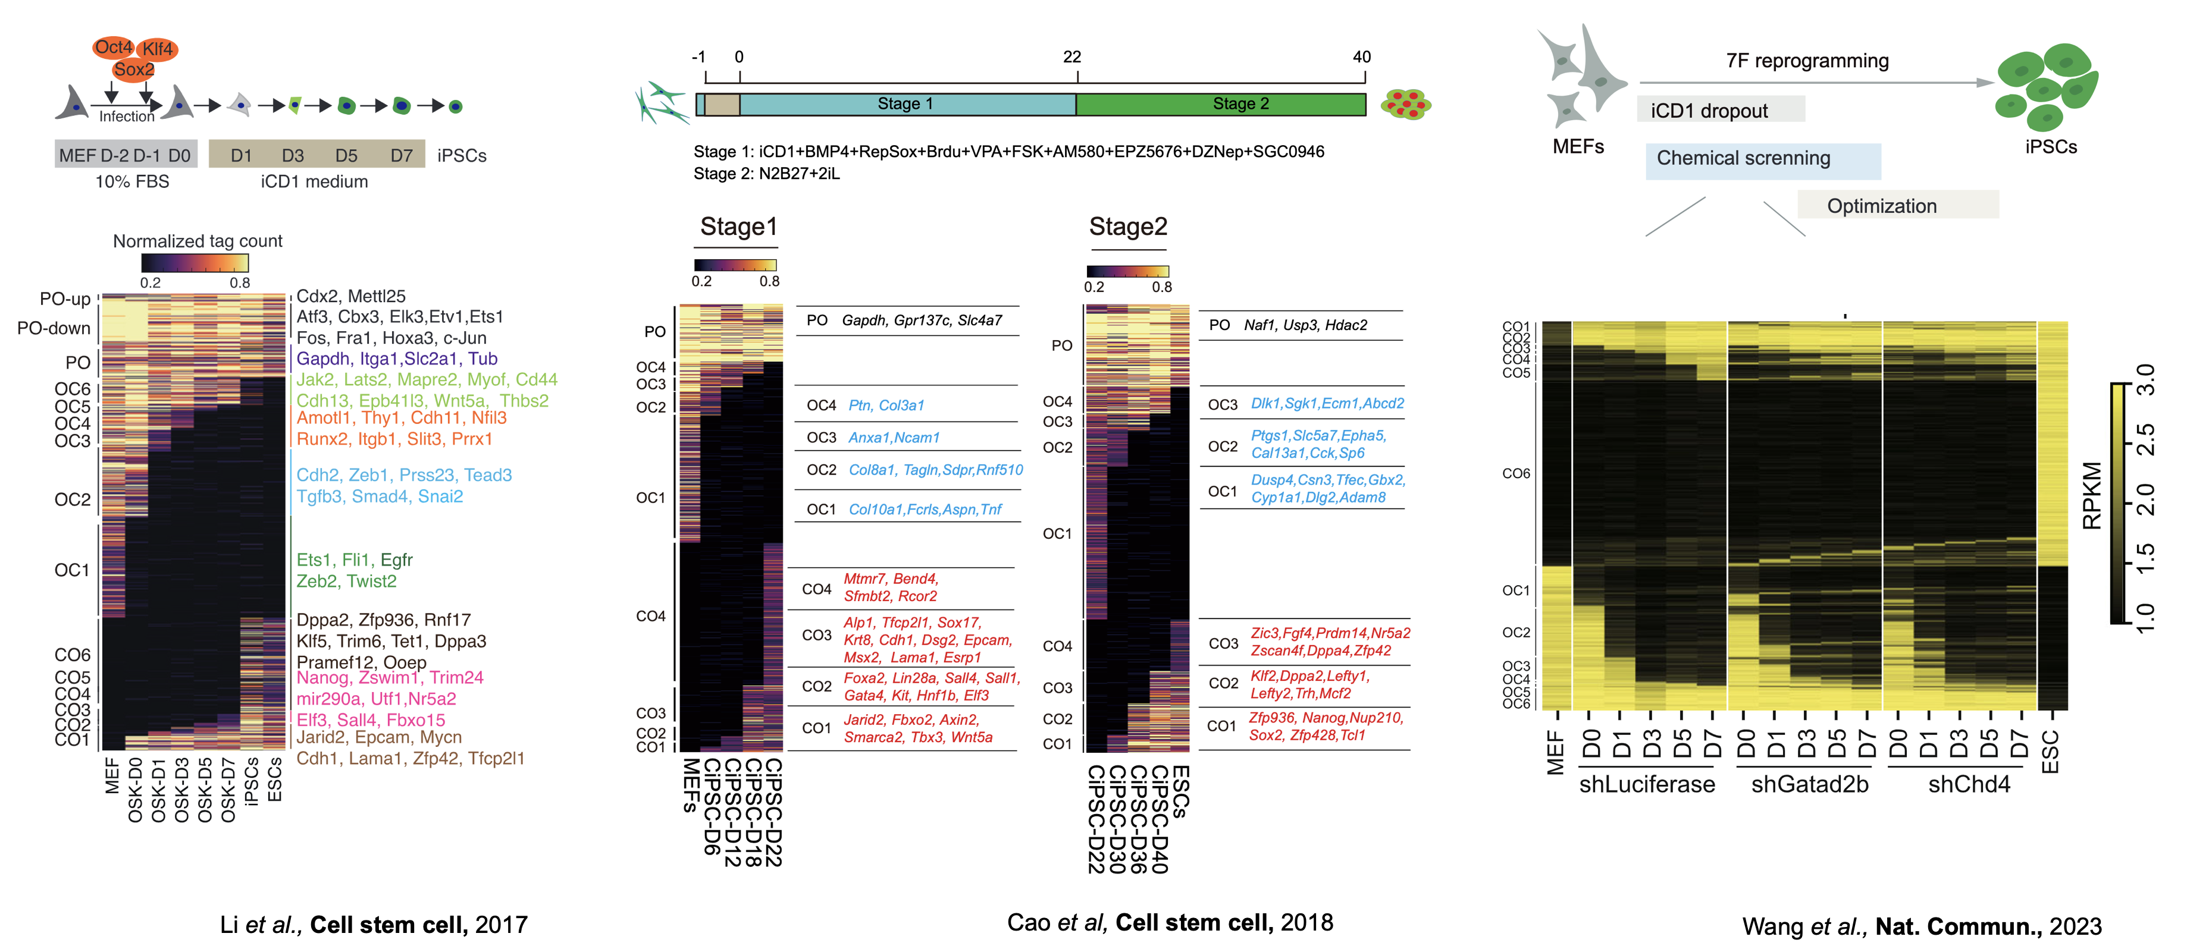
Dynamic pattern analysis
The purpose of ATAC dynamic pattern analysis is to mine peak sets that gradually open or close over time.
CO (Close to Open) represents the closed peak in MEF and the open peak in ESC;
OC (Open to Close) represents the open peak in MEF and the closed peak in ESC;
OC1 represents the peak where all days in the OC type are open;
OC2 represents the peak of the OC type that is open for all days except for the first day;
and so on.
Example
Credit : Wei Shi

Slide 23
Dynamic pattern analysis
Process
1. Sum the peak values of MEF and ESC together
2. Use bedtools dissect to find types such as OC1, OC2, etc
3. Calculate the signals of various types of peaks such as OC1, OC2, etc
4. Draw a heat map
5. Find the gene name of the promoter region where peak is located
Use
-m | Specify the mode (1:only one time datasets; 2:two time datasets) | -y | Specify the bw samples prefix(The first & last are terminal samples)
-i | Specify the absolute directory of peak files | -e | Specify the bw samples prefix(The first are terminal samples)
-j | Specify the absolute directory of bw files | -f | Specify the bw samples prefix(The last are terminal samples)
-o | Specify the absolute directory of output | -a | Specify the alias of samples
-x | Specify the peak samples prefix(The first & last are terminal samples) | -s | Specify the samples alias of dataset1
-c | Specify the peak samples prefix(The first are terminal samples) | -d | Specify the samples alias of dataset2
-d | Specify the peak samples prefix(The last are terminal samples)
# bash
bash ATACrc.sh
-m 2 -i /path/Peak -j /path/Bw
-c GSM7789740_e7_peaks,GSM7789744_e7_peaks,GSM7789745_e7_peaks
-d GSM7789752_e7_peaks,GSM7789753_e7_peaks,GSM7789754_e7_peaks
-e GSM7789740,GSM7789744,GSM7789745
-f GSM7789752,GSM7789753,GSM7789754
-s MEF,D0,D1 -t D0,D1,ESC -o /path/Fig2c
If mode is 1: you must input -i -j -o [-x -y -a]
If mode is 2: you must input -i -j -o -c -d -e -f [-s -t]
Credit : Wei Shi

Slide 24
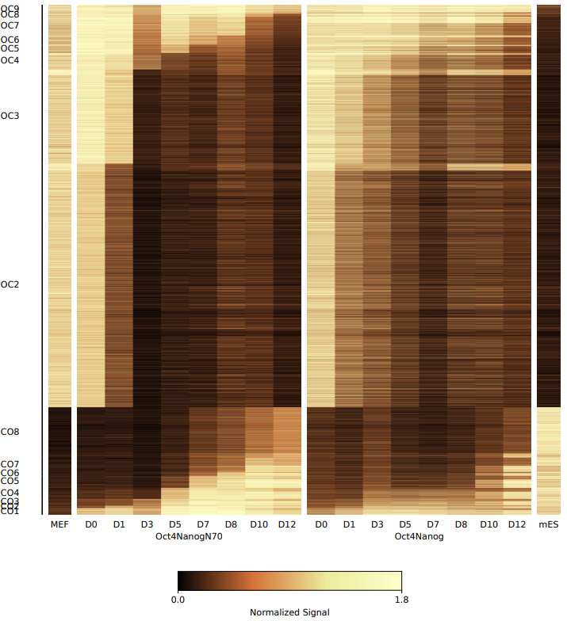
Dynamic pattern analysis
- Dynamic pattern analysis
Tools：CDesk
Input command line:
CDesk ATAC dynamic \
--file_meta /mnt/linzejie/CDesk_test/data/3.ATAC/3.dynamic/meta.csv \
--bed_dir /mnt/linzejie/CDesk_test/data/3.ATAC/3.dynamic/peak \
--bed_summit .e5_peaks.bed --remove_cluster CO9,OC1 \
--bw_dir /mnt/linzejie/CDesk_test/data/3.ATAC/3.dynamic/bw \
-o /mnt/linzejie/CDesk_test/result/3.ATAC/3.dynamic/group1 \
--important_index 0 --species mm10
Typical Parameter:
参数 | 描述 | 默认值
--file_meta√ | 样本信息文件 | -
--bed_dir√ | bed文件文件夹 | -
--bw_dir√ | bw文件文件夹 | -
-o√ | 输出结果存放位置 | -
--species√ | 选择物种 | mm10,rn7,hg38,susScr11,galGal6
--bed_summit√ | 选择的bed文件后缀 | .bed
--remove_cluster | 画热图时移除某类 | ‘’
--important_index | 画热图时按照后者(1)或前者(0)对齐 | 0
Notes:
python CDesk.py ATAC dynamic \
--mode 1 \
--bw /mnt/linzejie/CDesk_data/test/data/3.ATAC/3.Dynamic/Bw \
--peak /mnt/linzejie/CDesk_data/test/data/3.ATAC/3.Dynamic/Peak \
-o /mnt/linzejie/CDesk_data/test/result/3.ATAC/3.Dynamic/mode1 \
--species mm10 -t 50 \
--peak_sample GSM7789740_e7_peaks,GSM7789744_e7_peaks,GSM7789745_e7_peaks,GSM7789746_e7_peaks,GSM7789747_e7_peaks,GSM7789748_e7_peaks,GSM7789749_e7_peaks,GSM7789750_e7_peaks,GSM7789751_e7_peaks,GSM7789741_e7_peaks \
--bw_sample GSM7789740,GSM7789744,GSM7789745,GSM7789746,GSM7789747,GSM7789748,GSM7789749,GSM7789750,GSM7789751,GSM7789741 \
--sample_alias MEF,D0,D1,D3,D5,D7,D8,D10,D12,ESC
python CDesk.py ATAC dynamic \
--mode 2 \
--bw /mnt/linzejie/CDesk_data/test/data/3.ATAC/3.Dynamic/Bw \
--peak /mnt/linzejie/CDesk_data/test/data/3.ATAC/3.Dynamic/Peak \
-o /mnt/linzejie/CDesk_data/test/result/3.ATAC/3.Dynamic/mode2 \
--species mm10 -t 50 \
--peak_sample1 GSM7789740_e7_peaks,GSM7789744_e7_peaks,GSM7789745_e7_peaks,GSM7789746_e7_peaks,GSM7789747_e7_peaks,GSM7789748_e7_peaks,GSM7789749_e7_peaks,GSM7789750_e7_peaks,GSM7789751_e7_peaks \
--peak_sample2 GSM7789752_e7_peaks,GSM7789753_e7_peaks,GSM7789754_e7_peaks,GSM7789755_e7_peaks,GSM7789756_e7_peaks,GSM7789757_e7_peaks,GSM7789758_e7_peaks,GSM7789759_e7_peaks,GSM7789741_e7_peaks \
--bw_sample1 GSM7789740,GSM7789744,GSM7789745,GSM7789746,GSM7789747,GSM7789748,GSM7789749,GSM7789750,GSM7789751 \
--bw_sample2 GSM7789752,GSM7789753,GSM7789754,GSM7789755,GSM7789756,GSM7789757,GSM7789758,GSM7789759,GSM7789741 \
--sample_alias1 MEF,D0,D1,D3,D5,D7,D8,D10,D12 \
--sample_alias2 D0,D1,D3,D5,D7,D8,D10,D12,ESC

Slide 25
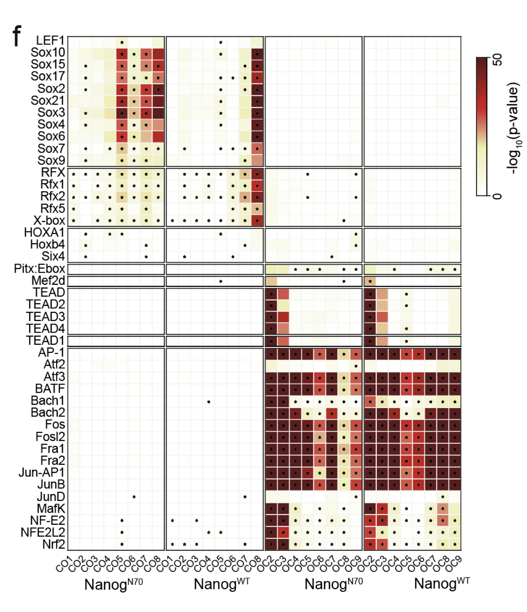
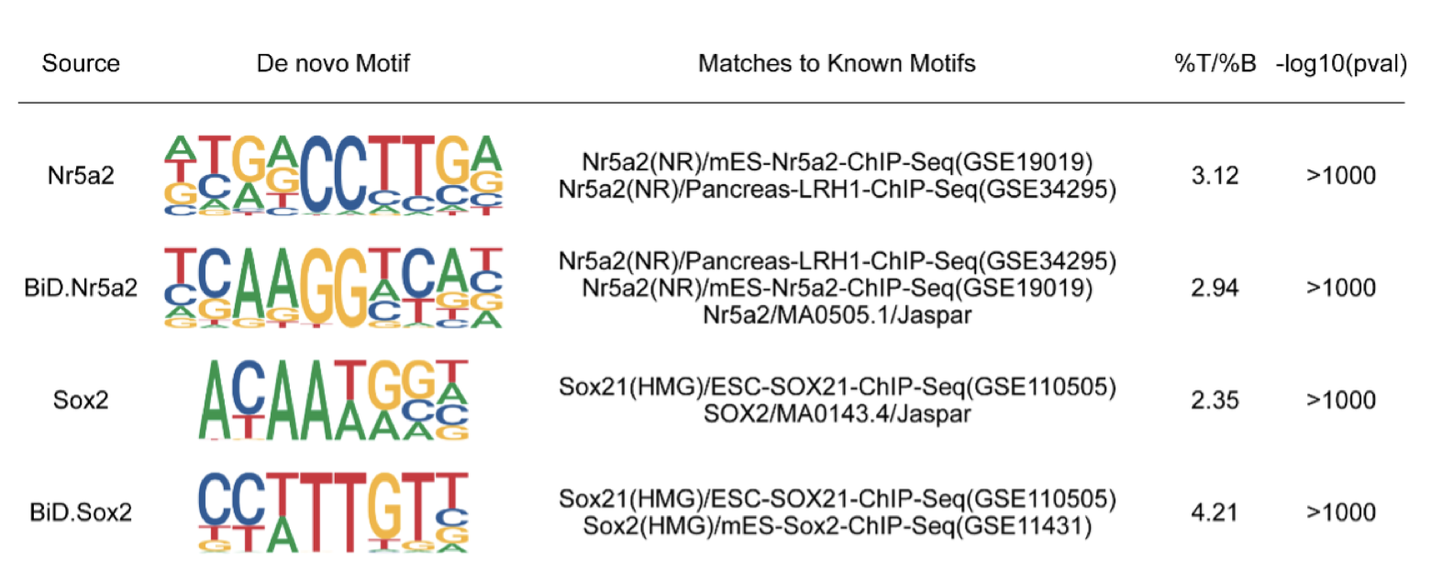
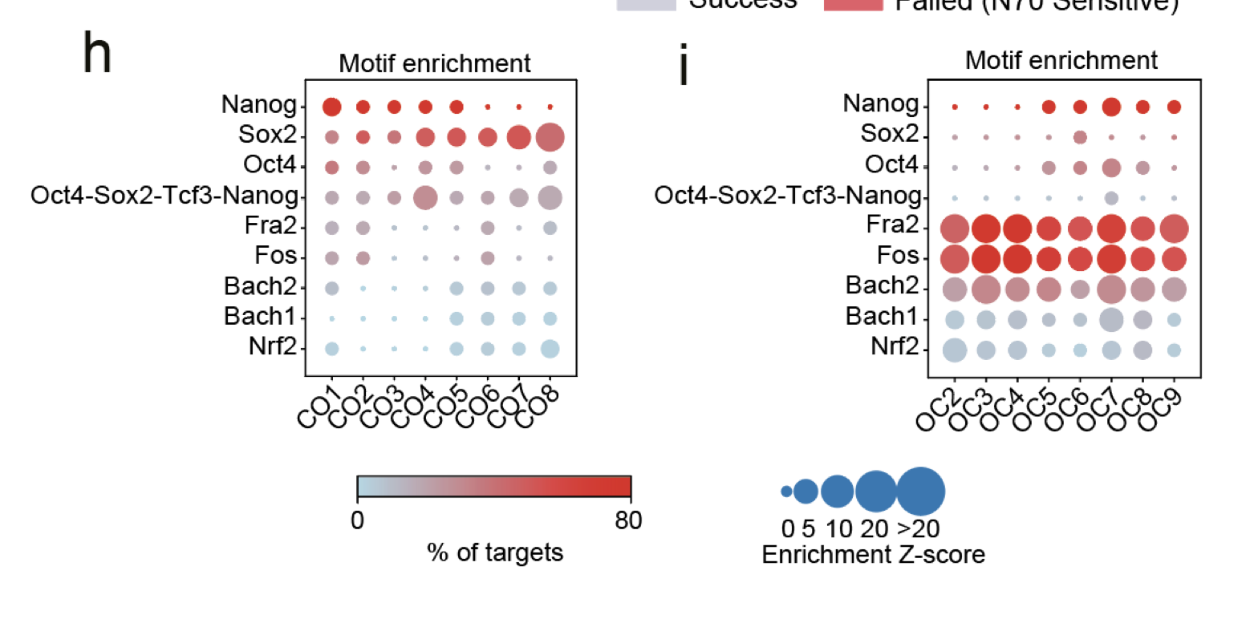
Motif analysis
Motif finding
Meme + Tomtom
HOMER
Motif display on specific region

Slide 26
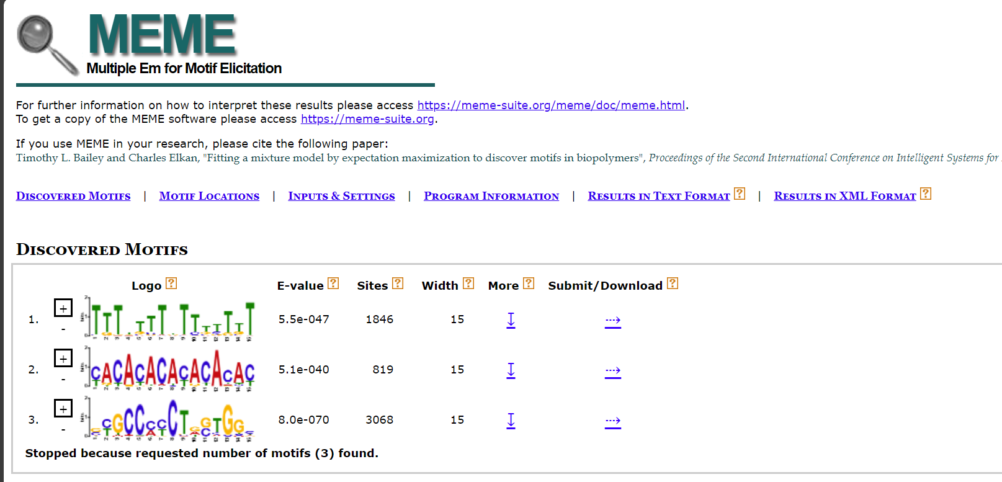
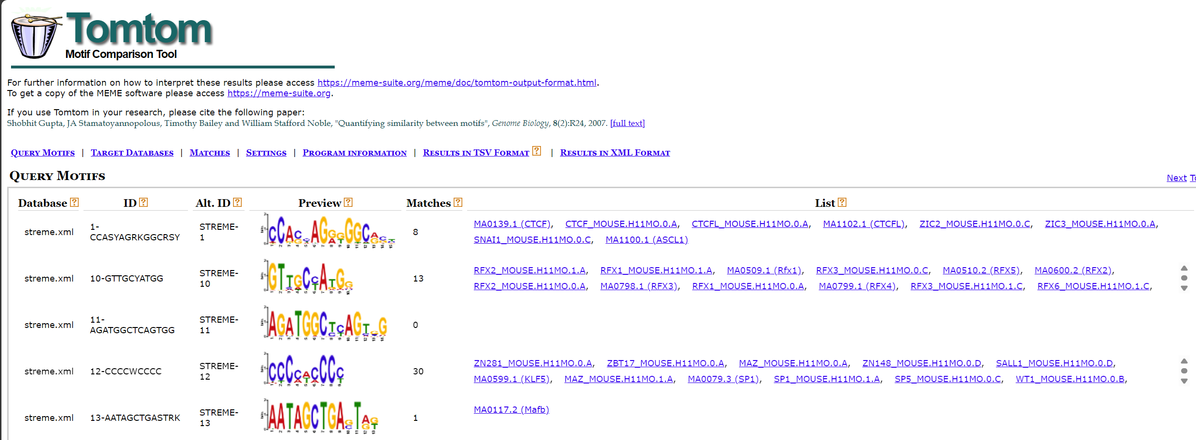
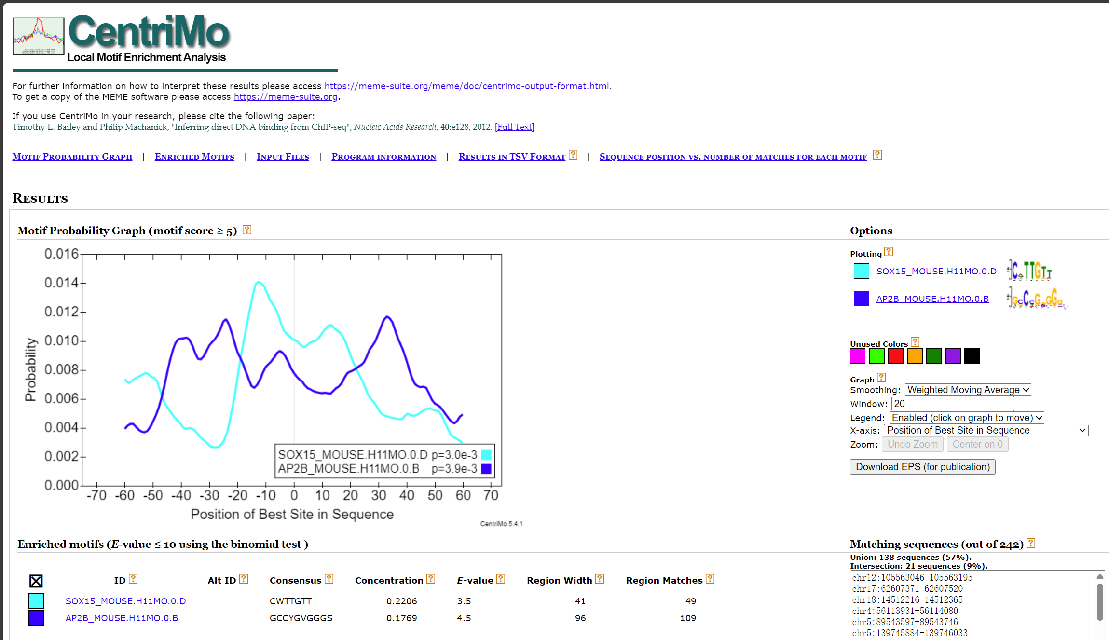
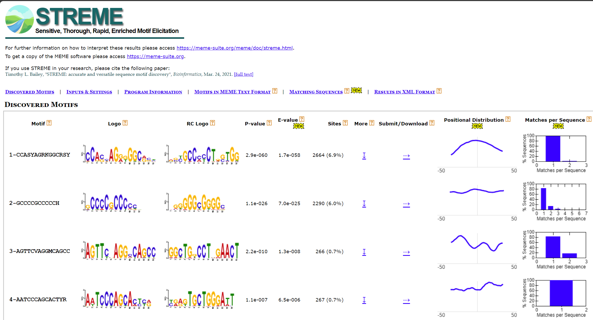
Motif analysis
Motif finding-meme
Command：
bash meme_motif.sh -i <input_file> -o <output_file>
Parameters:
-i: The peaks sequence fa file.
-o：Output directory path, used to save analysis results.
Example：
bash /mnt/kongtianci/CDesk/ACATseq/meme/meme_motif.sh
-i /mnt/kongtianci/CDesk/ACATseq/meme
-o /mnt/kongtianci/CDesk/ACATseq/output_results
Introduction - MEME Suite
MEME 使用简介 - 简书
Credit : Tianci Kong

Slide 27
Motif analysis
- Motif finding-meme
Tools：CDesk
Input command line:
CDesk ATAC motif meme_find \
-i /mnt/linzejie/CDesk_test/data/3.ATAC/4.motif/Find_meme \
-o /mnt/linzejie/CDesk_test/result/3.ATAC/4.motif/Find_meme \
--species mouse -t 100 --nmotifs 3
Typical Parameter:
参数 | 描述 | 默认值
-i√ | fasta文件文件夹 | -
--species√ | 物种 | (human,mouse)
-o√ | 存放输出结果的位置 | -
-t | 进程数 | 10
--nmotifs | meme输出motif数 | 3
Notes:
python CDesk.py ATAC dynamic \
--mode 1 \
--bw /mnt/linzejie/CDesk_data/test/data/3.ATAC/3.Dynamic/Bw \
--peak /mnt/linzejie/CDesk_data/test/data/3.ATAC/3.Dynamic/Peak \
-o /mnt/linzejie/CDesk_data/test/result/3.ATAC/3.Dynamic/mode1 \
--species mm10 -t 50 \
--peak_sample GSM7789740_e7_peaks,GSM7789744_e7_peaks,GSM7789745_e7_peaks,GSM7789746_e7_peaks,GSM7789747_e7_peaks,GSM7789748_e7_peaks,GSM7789749_e7_peaks,GSM7789750_e7_peaks,GSM7789751_e7_peaks,GSM7789741_e7_peaks \
--bw_sample GSM7789740,GSM7789744,GSM7789745,GSM7789746,GSM7789747,GSM7789748,GSM7789749,GSM7789750,GSM7789751,GSM7789741 \
--sample_alias MEF,D0,D1,D3,D5,D7,D8,D10,D12,ESC
python CDesk.py ATAC dynamic \
--mode 2 \
--bw /mnt/linzejie/CDesk_data/test/data/3.ATAC/3.Dynamic/Bw \
--peak /mnt/linzejie/CDesk_data/test/data/3.ATAC/3.Dynamic/Peak \
-o /mnt/linzejie/CDesk_data/test/result/3.ATAC/3.Dynamic/mode2 \
--species mm10 -t 50 \
--peak_sample1 GSM7789740_e7_peaks,GSM7789744_e7_peaks,GSM7789745_e7_peaks,GSM7789746_e7_peaks,GSM7789747_e7_peaks,GSM7789748_e7_peaks,GSM7789749_e7_peaks,GSM7789750_e7_peaks,GSM7789751_e7_peaks \
--peak_sample2 GSM7789752_e7_peaks,GSM7789753_e7_peaks,GSM7789754_e7_peaks,GSM7789755_e7_peaks,GSM7789756_e7_peaks,GSM7789757_e7_peaks,GSM7789758_e7_peaks,GSM7789759_e7_peaks,GSM7789741_e7_peaks \
--bw_sample1 GSM7789740,GSM7789744,GSM7789745,GSM7789746,GSM7789747,GSM7789748,GSM7789749,GSM7789750,GSM7789751 \
--bw_sample2 GSM7789752,GSM7789753,GSM7789754,GSM7789755,GSM7789756,GSM7789757,GSM7789758,GSM7789759,GSM7789741 \
--sample_alias1 MEF,D0,D1,D3,D5,D7,D8,D10,D12 \
--sample_alias2 D0,D1,D3,D5,D7,D8,D10,D12,ESC

Slide 28
Motif analysis
Motif finding-homer
Command：
bash findmotif.sh -i <input_file -o <output_file>
Parameters:
-i: Peaks file directory in bed format.
-o：Output directory path, used to save analysis results.
Example：
bash /mnt/kongtianci/CDesk/ACATseq/homer_results/findmotif.sh
-i /mnt/shiwei/Work/05_pipeline/ATACseq/preprocessed/Peak
-o /mnt/kongtianci/CDesk/ACATseq/homer_results/
Credit : Tianci Kong

Slide 29
Motif analysis
- Motif finding-homer
Tools：CDesk
Input command line:
CDesk ATAC motif homer_heatmap \
--homer_results /mnt/linzejie/CDesk_test/data/3.ATAC/4.motif/homer_heatmap/homer_results_test \
--group /mnt/linzejie/CDesk_test/data/3.ATAC/4.motif/homer_heatmap/motif_group.csv \
--motifs /mnt/linzejie/CDesk_test/data/3.ATAC/4.motif/homer_heatmap/p53_p63.txt \
-o /mnt/linzejie/CDesk_test/result/3.ATAC/4.motif/homer_heatmap \
--log_p_filter -2 --log_p_point -5 --log_p_min -60 --ratio 3
Typical Parameter:
参数 | 描述 | 默认值
--homer_results√ | homer运行结果文件夹 | -
--group√ | 分组信息 | -
--motifs√ | 选择绘制的感兴趣相关motif | -
-o√ | 输出结果文件夹 | -
--log_p_filter | homer结果-lg p值过滤阈值 | -2
--log_p_point | -lg p值星号标注 | -5
--log_p_min | 画图最小-lg p值 | -50
--ratio | % of Target Sequences with Motif/% of Background Sequences with Motif， ratio星号标注 | 3
Notes:
python CDesk.py ATAC dynamic \
--mode 1 \
--bw /mnt/linzejie/CDesk_data/test/data/3.ATAC/3.Dynamic/Bw \
--peak /mnt/linzejie/CDesk_data/test/data/3.ATAC/3.Dynamic/Peak \
-o /mnt/linzejie/CDesk_data/test/result/3.ATAC/3.Dynamic/mode1 \
--species mm10 -t 50 \
--peak_sample GSM7789740_e7_peaks,GSM7789744_e7_peaks,GSM7789745_e7_peaks,GSM7789746_e7_peaks,GSM7789747_e7_peaks,GSM7789748_e7_peaks,GSM7789749_e7_peaks,GSM7789750_e7_peaks,GSM7789751_e7_peaks,GSM7789741_e7_peaks \
--bw_sample GSM7789740,GSM7789744,GSM7789745,GSM7789746,GSM7789747,GSM7789748,GSM7789749,GSM7789750,GSM7789751,GSM7789741 \
--sample_alias MEF,D0,D1,D3,D5,D7,D8,D10,D12,ESC
python CDesk.py ATAC dynamic \
--mode 2 \
--bw /mnt/linzejie/CDesk_data/test/data/3.ATAC/3.Dynamic/Bw \
--peak /mnt/linzejie/CDesk_data/test/data/3.ATAC/3.Dynamic/Peak \
-o /mnt/linzejie/CDesk_data/test/result/3.ATAC/3.Dynamic/mode2 \
--species mm10 -t 50 \
--peak_sample1 GSM7789740_e7_peaks,GSM7789744_e7_peaks,GSM7789745_e7_peaks,GSM7789746_e7_peaks,GSM7789747_e7_peaks,GSM7789748_e7_peaks,GSM7789749_e7_peaks,GSM7789750_e7_peaks,GSM7789751_e7_peaks \
--peak_sample2 GSM7789752_e7_peaks,GSM7789753_e7_peaks,GSM7789754_e7_peaks,GSM7789755_e7_peaks,GSM7789756_e7_peaks,GSM7789757_e7_peaks,GSM7789758_e7_peaks,GSM7789759_e7_peaks,GSM7789741_e7_peaks \
--bw_sample1 GSM7789740,GSM7789744,GSM7789745,GSM7789746,GSM7789747,GSM7789748,GSM7789749,GSM7789750,GSM7789751 \
--bw_sample2 GSM7789752,GSM7789753,GSM7789754,GSM7789755,GSM7789756,GSM7789757,GSM7789758,GSM7789759,GSM7789741 \
--sample_alias1 MEF,D0,D1,D3,D5,D7,D8,D10,D12 \
--sample_alias2 D0,D1,D3,D5,D7,D8,D10,D12,ESC

Slide 30
Motif analysis
Motif finding-plot
Command：
python 3e.3f.3g.py --file_meta < meta.xlsx> --bed_file_dir < bed_file> --bed_file_ext < _e5_peaks> --summit_file_ext <_e5_summits> -- promoter_file< promoter_file> --tf_file<TF_file> --species<species> --bw_dir<bw_dir> --result_dir <result_dir>
Example：
python /mnt/kongtianci/CDesk/ACATseq/3e.3f.3g.py
--file_meta /mnt/kongtianci/CDesk/ACATseq/Nanog.heatmap.meta.xlsx
--bed_file_dir /mnt/shiwei/Work/05_pipeline/ATACseq/preprocessed/Peak/
--bed_file_ext _e5_peaks --summit_file_ext _e5_summits
--promoter_file /mnt/liudong/data/Genome/mm10/mm10.promoter.ncbiRefSeq.WithUCSC.bed
--tf_file /mnt/zhaochengchen/Data/mm10/Mus_musculus_TF.txt --species mm10
--bw_dir /mnt/shiwei/Work/05_pipeline/ATACseq/preprocessed/Bw
--result_dir /mnt/kongtianci/CDesk/ACATseq/out_resluts/
Credit : Tianci Kong

Slide 31
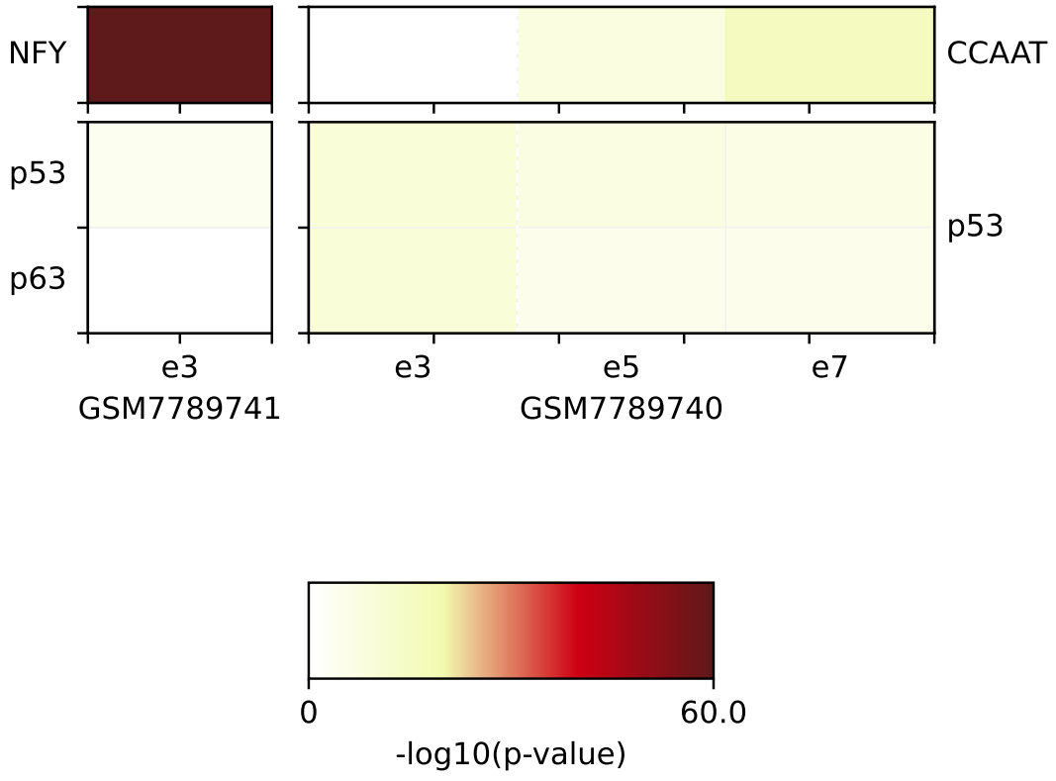
Motif analysis
- Motif finding-plot
Tools：CDesk
Input command line:
CDesk ATAC motif homer_heatmap \
--homer_results /mnt/linzejie/CDesk_test/data/3.ATAC/4.motif/homer_heatmap/homer_results_test \
--group /mnt/linzejie/CDesk_test/data/3.ATAC/4.motif/homer_heatmap/motif_group.csv \
--motifs /mnt/linzejie/CDesk_test/data/3.ATAC/4.motif/homer_heatmap/p53_p63.txt \
-o /mnt/linzejie/CDesk_test/result/3.ATAC/4.motif/homer_heatmap \
--log_p_filter -2 --log_p_point -5 --log_p_min -60 --ratio 3
Typical Parameter:
参数 | 描述 | 默认值
--homer_results√ | homer运行结果文件夹 | -
--group√ | 分组信息 | -
--motifs√ | 选择绘制的感兴趣相关motif | -
-o√ | 输出结果文件夹 | -
--log_p_filter | homer结果-lg p值过滤阈值 | -2
--log_p_point | -lg p值星号标注 | -5
--log_p_min | 画图最小-lg p值 | -50
--ratio | % of Target Sequences with Motif/% of Background Sequences with Motif， ratio星号标注 | 3
Notes:
python CDesk.py ATAC dynamic \
--mode 1 \
--bw /mnt/linzejie/CDesk_data/test/data/3.ATAC/3.Dynamic/Bw \
--peak /mnt/linzejie/CDesk_data/test/data/3.ATAC/3.Dynamic/Peak \
-o /mnt/linzejie/CDesk_data/test/result/3.ATAC/3.Dynamic/mode1 \
--species mm10 -t 50 \
--peak_sample GSM7789740_e7_peaks,GSM7789744_e7_peaks,GSM7789745_e7_peaks,GSM7789746_e7_peaks,GSM7789747_e7_peaks,GSM7789748_e7_peaks,GSM7789749_e7_peaks,GSM7789750_e7_peaks,GSM7789751_e7_peaks,GSM7789741_e7_peaks \
--bw_sample GSM7789740,GSM7789744,GSM7789745,GSM7789746,GSM7789747,GSM7789748,GSM7789749,GSM7789750,GSM7789751,GSM7789741 \
--sample_alias MEF,D0,D1,D3,D5,D7,D8,D10,D12,ESC
python CDesk.py ATAC dynamic \
--mode 2 \
--bw /mnt/linzejie/CDesk_data/test/data/3.ATAC/3.Dynamic/Bw \
--peak /mnt/linzejie/CDesk_data/test/data/3.ATAC/3.Dynamic/Peak \
-o /mnt/linzejie/CDesk_data/test/result/3.ATAC/3.Dynamic/mode2 \
--species mm10 -t 50 \
--peak_sample1 GSM7789740_e7_peaks,GSM7789744_e7_peaks,GSM7789745_e7_peaks,GSM7789746_e7_peaks,GSM7789747_e7_peaks,GSM7789748_e7_peaks,GSM7789749_e7_peaks,GSM7789750_e7_peaks,GSM7789751_e7_peaks \
--peak_sample2 GSM7789752_e7_peaks,GSM7789753_e7_peaks,GSM7789754_e7_peaks,GSM7789755_e7_peaks,GSM7789756_e7_peaks,GSM7789757_e7_peaks,GSM7789758_e7_peaks,GSM7789759_e7_peaks,GSM7789741_e7_peaks \
--bw_sample1 GSM7789740,GSM7789744,GSM7789745,GSM7789746,GSM7789747,GSM7789748,GSM7789749,GSM7789750,GSM7789751 \
--bw_sample2 GSM7789752,GSM7789753,GSM7789754,GSM7789755,GSM7789756,GSM7789757,GSM7789758,GSM7789759,GSM7789741 \
--sample_alias1 MEF,D0,D1,D3,D5,D7,D8,D10,D12 \
--sample_alias2 D0,D1,D3,D5,D7,D8,D10,D12,ESC

Slide 32
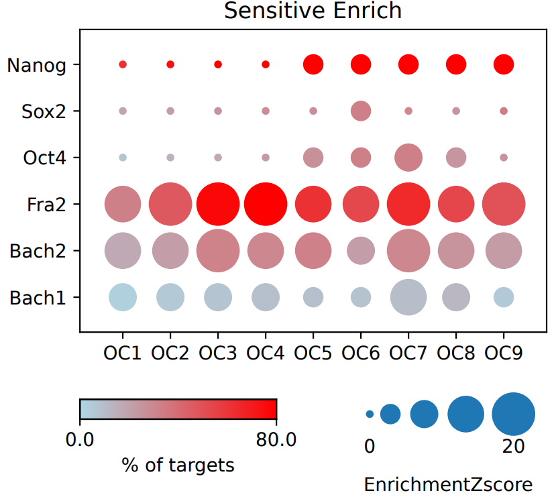
Motif analysis
- Motif finding-plot
Tools：CDesk
Input command line:
CDesk ATAC motif enrich_heatmap \
--motif_bed /mnt/linzejie/CDesk_test/data/3.ATAC/4.motif/enrich_heatmap/motif \
-o /mnt/linzejie/CDesk_test/result/3.ATAC/4.motif/enrich_heatmap \
--bed /mnt/linzejie/CDesk_test/data/3.ATAC/4.motif/enrich_heatmap/bed \
--motifs /mnt/linzejie/CDesk_test/data/3.ATAC/4.motif/enrich_heatmap/motif.txt \
-t 100 --tag CO,OC --species mm10
Typical Parameter:
参数 | 描述 | 默认值
--bed√ | bed文件存放文件夹 | -
--motif_bed√ | 感兴趣基因组区域bed文件文件夹 | -
--motifs√ | 感兴趣相关基因文件 | -
-o√ | 输出结果文件夹 | -
-t | 线程数 | 12
--tag | 样本选择标签，绘图分组 | CO,OC
--species | 物种 | mm10
Notes:
python CDesk.py ATAC dynamic \
--mode 1 \
--bw /mnt/linzejie/CDesk_data/test/data/3.ATAC/3.Dynamic/Bw \
--peak /mnt/linzejie/CDesk_data/test/data/3.ATAC/3.Dynamic/Peak \
-o /mnt/linzejie/CDesk_data/test/result/3.ATAC/3.Dynamic/mode1 \
--species mm10 -t 50 \
--peak_sample GSM7789740_e7_peaks,GSM7789744_e7_peaks,GSM7789745_e7_peaks,GSM7789746_e7_peaks,GSM7789747_e7_peaks,GSM7789748_e7_peaks,GSM7789749_e7_peaks,GSM7789750_e7_peaks,GSM7789751_e7_peaks,GSM7789741_e7_peaks \
--bw_sample GSM7789740,GSM7789744,GSM7789745,GSM7789746,GSM7789747,GSM7789748,GSM7789749,GSM7789750,GSM7789751,GSM7789741 \
--sample_alias MEF,D0,D1,D3,D5,D7,D8,D10,D12,ESC
python CDesk.py ATAC dynamic \
--mode 2 \
--bw /mnt/linzejie/CDesk_data/test/data/3.ATAC/3.Dynamic/Bw \
--peak /mnt/linzejie/CDesk_data/test/data/3.ATAC/3.Dynamic/Peak \
-o /mnt/linzejie/CDesk_data/test/result/3.ATAC/3.Dynamic/mode2 \
--species mm10 -t 50 \
--peak_sample1 GSM7789740_e7_peaks,GSM7789744_e7_peaks,GSM7789745_e7_peaks,GSM7789746_e7_peaks,GSM7789747_e7_peaks,GSM7789748_e7_peaks,GSM7789749_e7_peaks,GSM7789750_e7_peaks,GSM7789751_e7_peaks \
--peak_sample2 GSM7789752_e7_peaks,GSM7789753_e7_peaks,GSM7789754_e7_peaks,GSM7789755_e7_peaks,GSM7789756_e7_peaks,GSM7789757_e7_peaks,GSM7789758_e7_peaks,GSM7789759_e7_peaks,GSM7789741_e7_peaks \
--bw_sample1 GSM7789740,GSM7789744,GSM7789745,GSM7789746,GSM7789747,GSM7789748,GSM7789749,GSM7789750,GSM7789751 \
--bw_sample2 GSM7789752,GSM7789753,GSM7789754,GSM7789755,GSM7789756,GSM7789757,GSM7789758,GSM7789759,GSM7789741 \
--sample_alias1 MEF,D0,D1,D3,D5,D7,D8,D10,D12 \
--sample_alias2 D0,D1,D3,D5,D7,D8,D10,D12,ESC

Slide 33
Motif analysis
python CDesk/ACATseq/3h.3i.py -g "/mnt/kongtianci/CDesk/ACATseq/specific_region/genes.txt" -c "/mnt/kongtianci/CDesk/ACATseq/specific_region/cluster_fail" -m "/mnt/kongtianci/CDesk/ACATseq/specific_region/motif" -o "/mnt/kongtianci/CDesk/ACATseq/specific_region/results
Motif display on specific region
Command：
bash process_motifs.sh -b < bed_dir > -g < gene_list_file > -o <output_dir >
Parameters:
-b : bed_file.
-g : geneset.
-o：Output directory path, used to save analysis results.
Example：
bash /mnt/kongtianci/CDesk/ACATseq/specific_region/process_motifs.sh
-b /mnt/shiwei/Work/05_pipeline/ATACseq/preprocessed/Bed
-g /mnt/kongtianci/CDesk/ACATseq/specific_region/genes.txt
-o /mnt/kongtianci/CDesk/ACATseq/specific_region/motif
Credit : Tianci Kong

Slide 34
Accessibility in selected regions
Specific regions
Selected genes (promoter)
Average profile
Boxplot
Credit : Tiancheng Yu

Slide 35
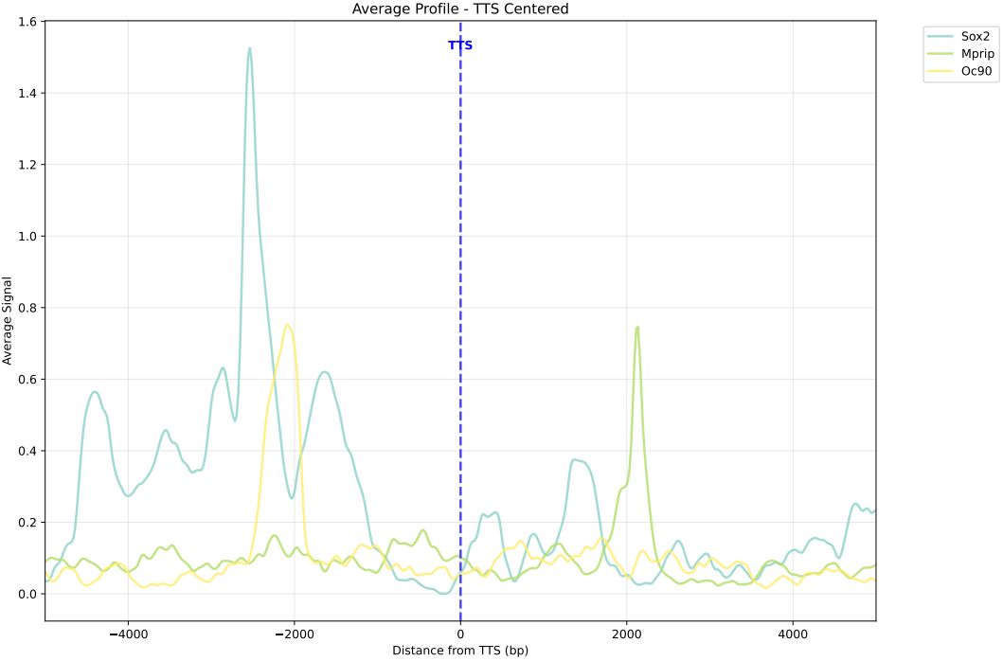
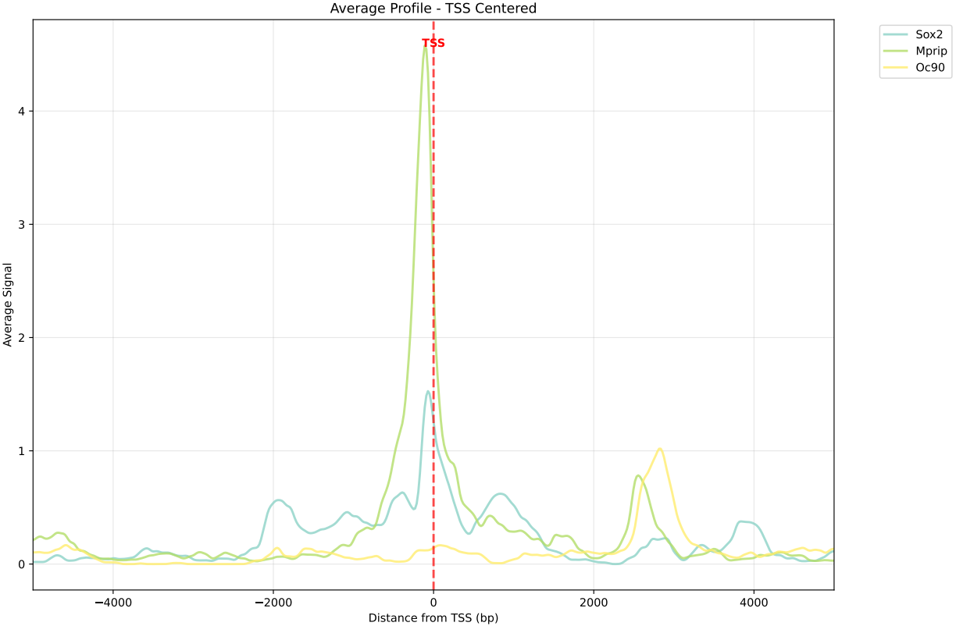
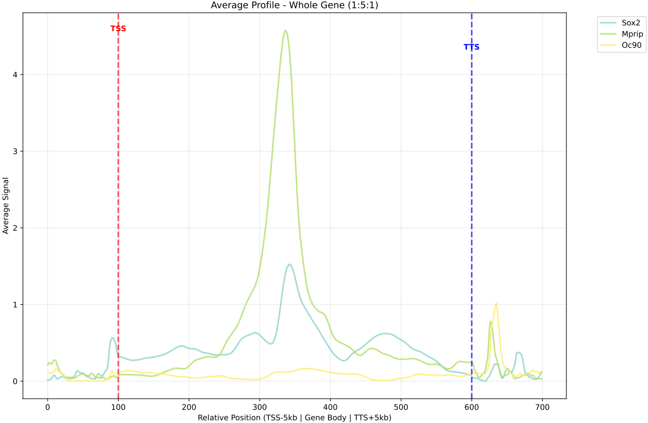
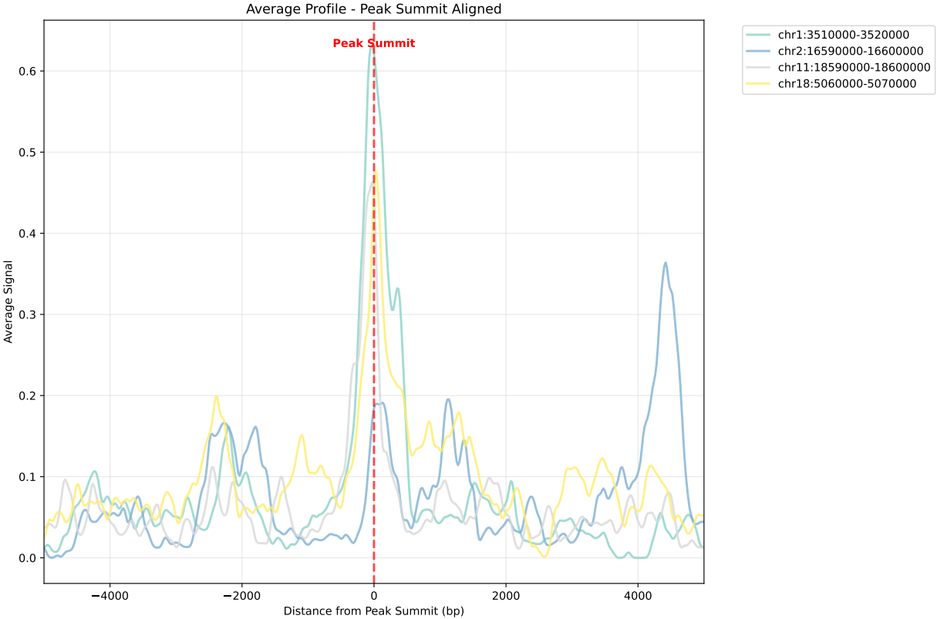
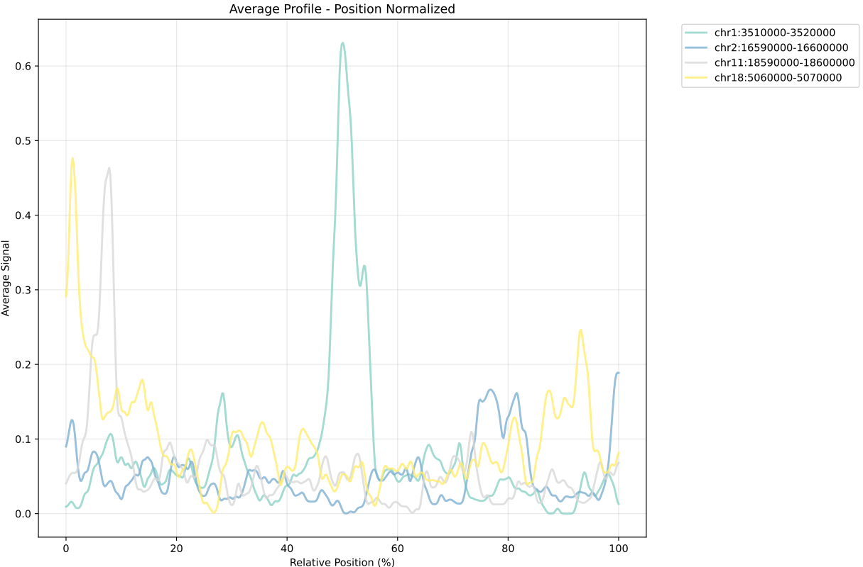
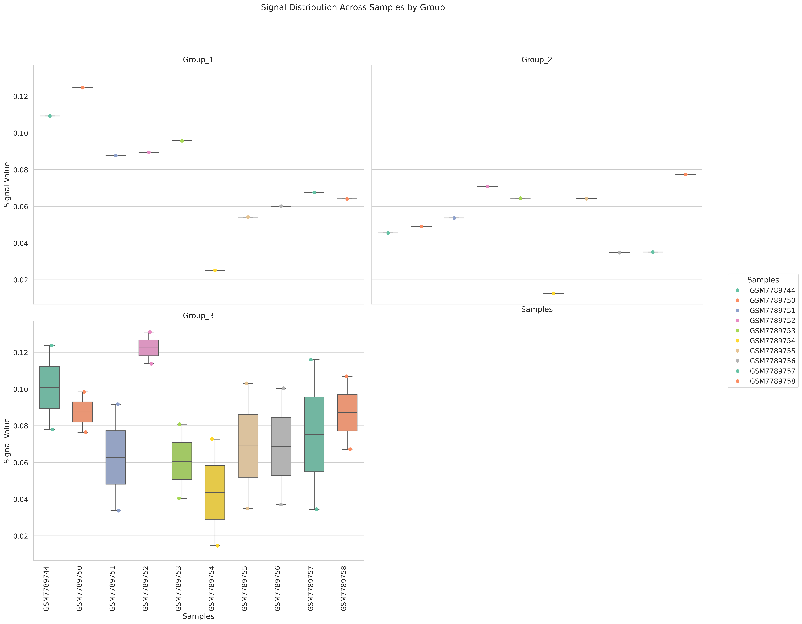
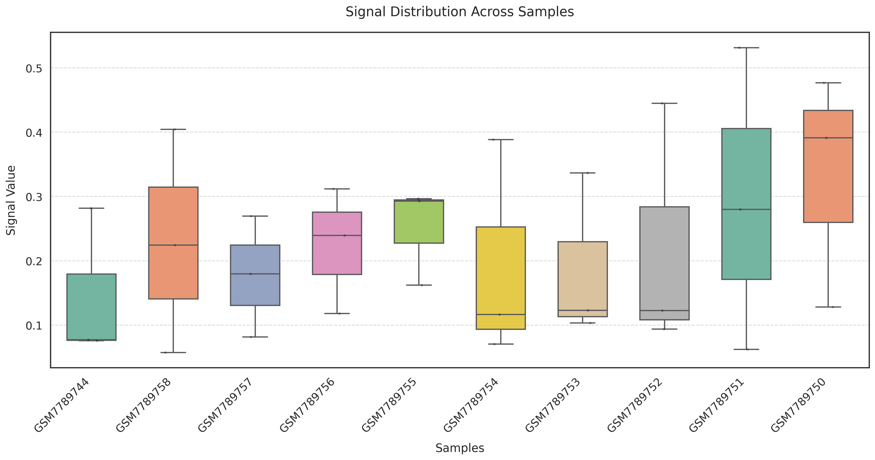
Accessibility in selected regions
- Accessibility in selected regions
Input command line:
Tools：CDesk
CDesk ATAC accessbility \
--bw /mnt/linzejie/CDesk_test/data/3.ATAC/5.accessbility/bw.txt \
-o /mnt/linzejie/CDesk_test/result/3.ATAC/5.accessbility/region \
-i /mnt/linzejie/CDesk_test/data/3.ATAC/5.accessbility/regions_fixed.bed \
--mode region --method region_list --center position \
--region_list /mnt/linzejie/CDesk_test/data/3.ATAC/5.accessbility/test.txt
Typical Parameter:
参数 | 描述 | 默认值
-bw√ | bw文件列表 | -
--mode√ | 分析模式按基因或区域位置 | region/gene
-i√ | 基因区域或基因列表 | -
-o√ | 存放输出结果的位置 | -
--species | 物种信息，gene模式下需要提供，否则报错 | hg38,mm10,galGal6,rn7,susScr11
--method | boxplot绘制方法：sample（样本为列）或region_list（区域列表为列） | sample
--region_list | region_list模式下的区域列表文件（每行包含多个基因/区域）
--promoter_size | 基因启动子区域大小（默认：TSS上下游各5kb） | 5000
--center | average_profile对齐方式：region模式可选peak/position，gene模式可选TSS/TTS/whole | position/peak whole/TSS/TTS

Slide 36
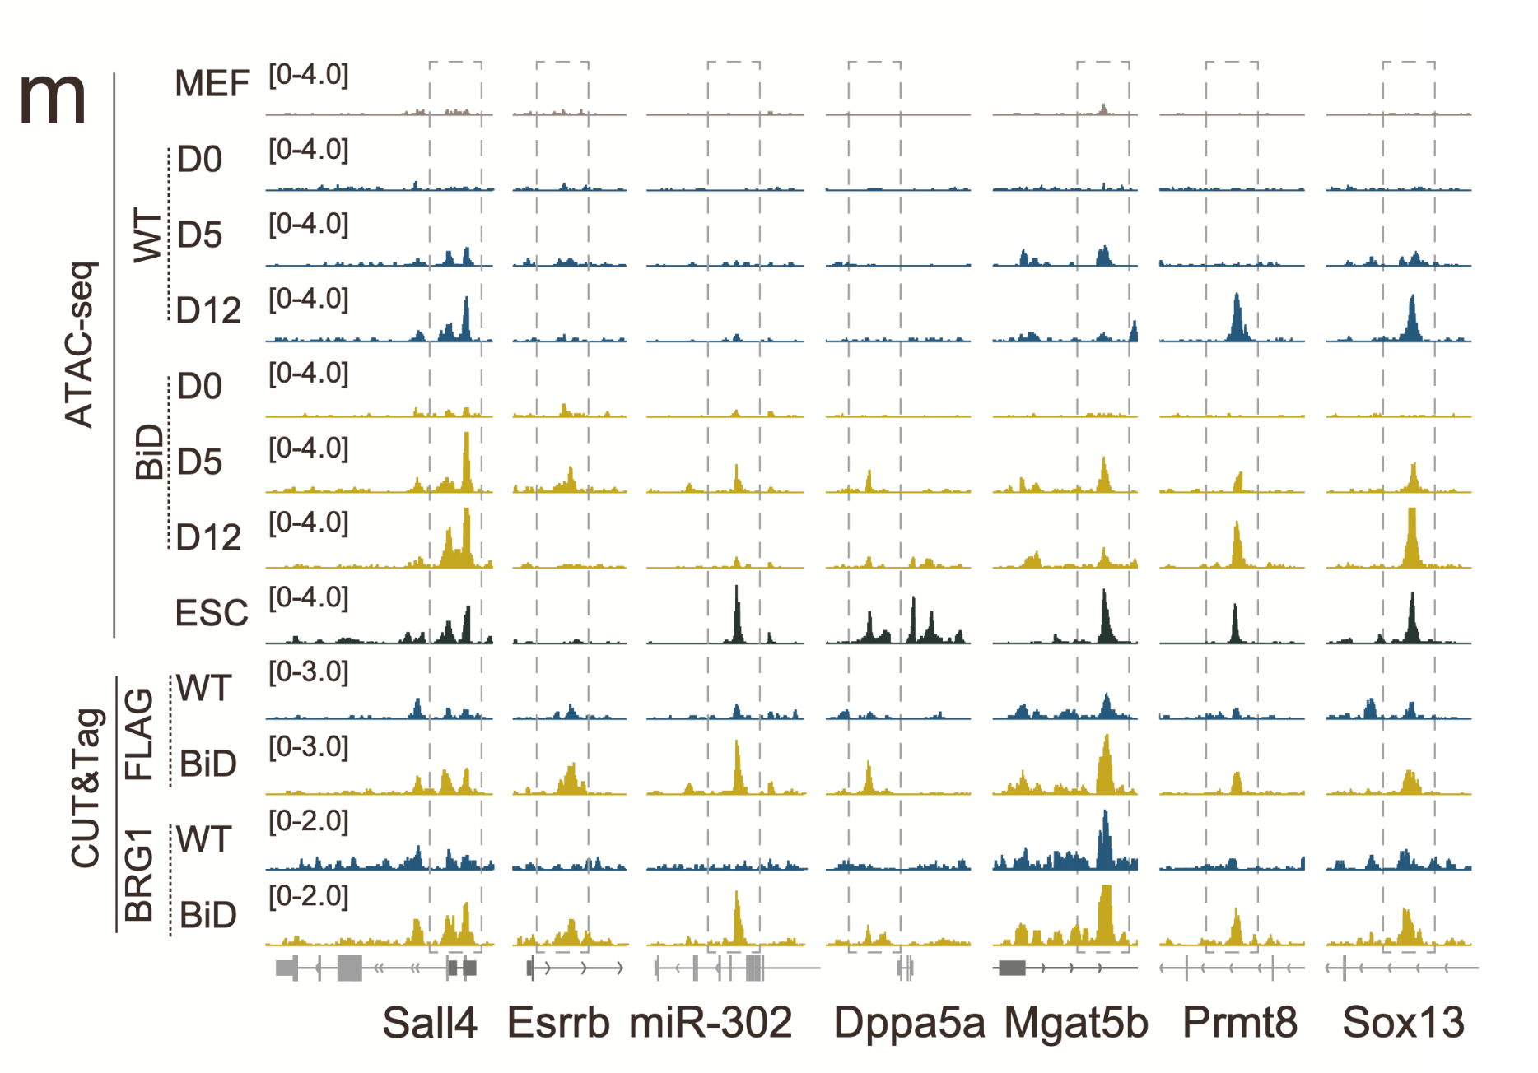
Visualization in IGV
Credit : Jingyu Yang

Slide 37
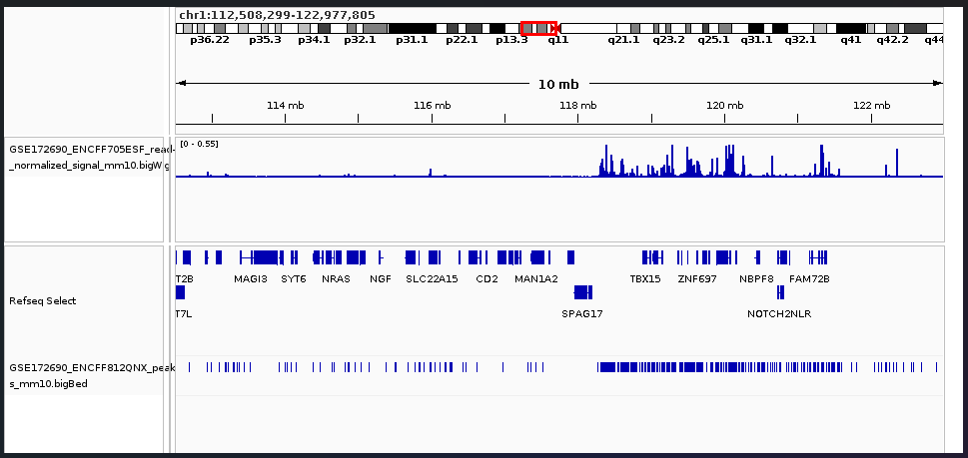
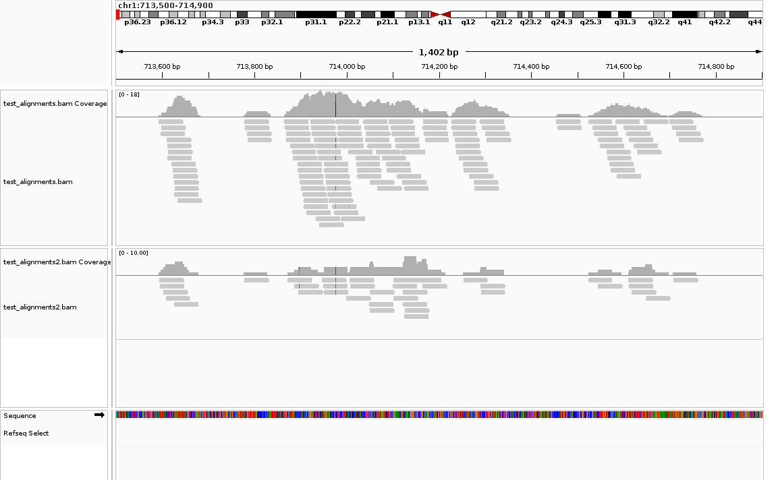
Visualization in IGV
- IGV snapshots
Tools：CDesk
Input command line:
Typical Parameter:
CDesk ATAC igv \
-i /mnt/linzejie/CDesk_test/data/3.ATAC/6.igv/test_alignments.bam,/mnt/linzejie/CDesk_test/data/3.ATAC/6.igv/test_alignments2.bam \
-o /mnt/linzejie/CDesk_test/result/3.ATAC/6.igv \
--genome hg19 --region /mnt/linzejie/CDesk_test/data/3.ATAC/6.igv/region.txt --type png
参数 | 描述 | 默认值
-i√ | 选择bam文件，逗号分隔 | -
-o√ | 分析模式按基因或区域位置 | region/gene
--genome√ | 基因区域或基因列表 | -
--region√ | 存放输出结果的位置 | -
--display_mode | 显示格式（collapse/expand/squish） | collapse
--type | 截图输出格式 | svg/png

Slide 38
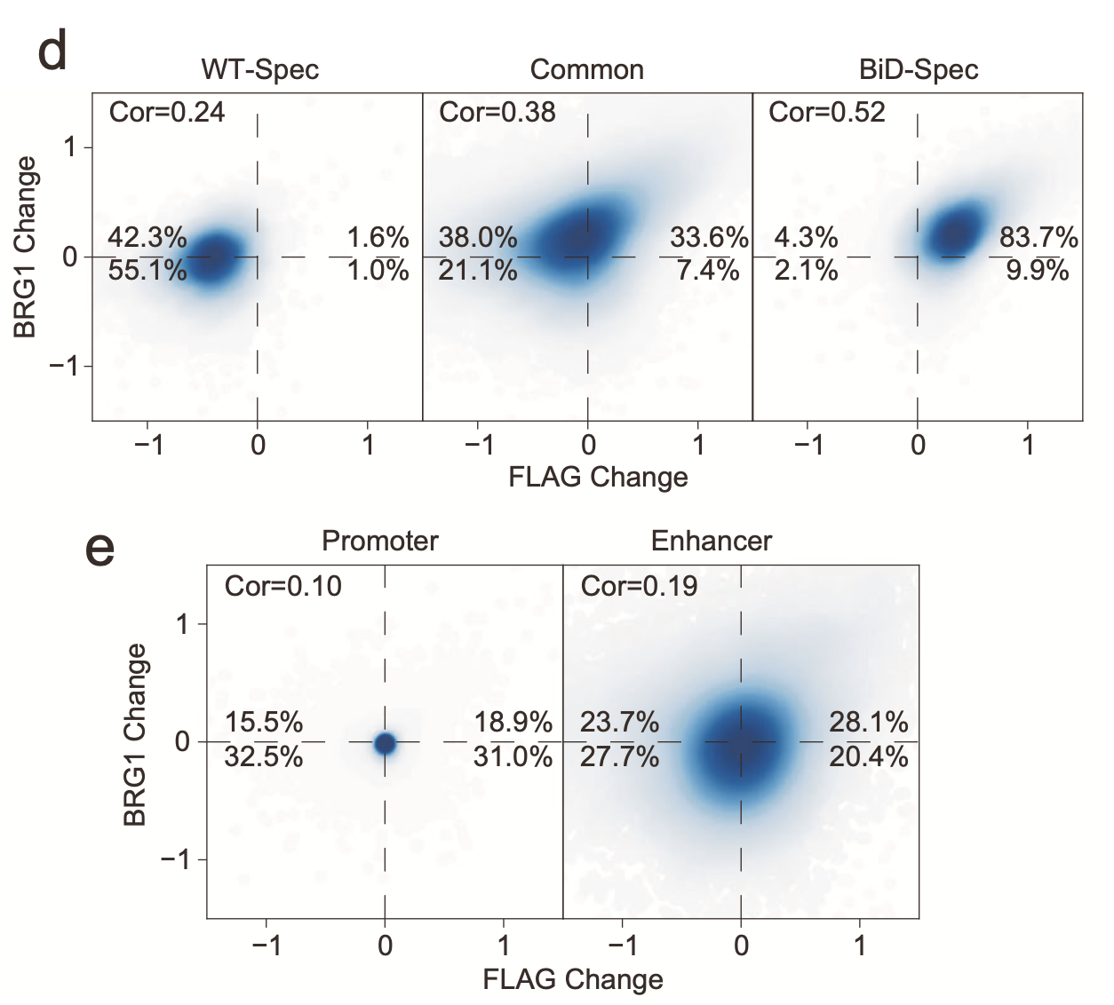
Correlation analysis
Replicates correlation(QC)
Similarity
Co-binding with other features
Credit : Zheting Zhang

Slide 39
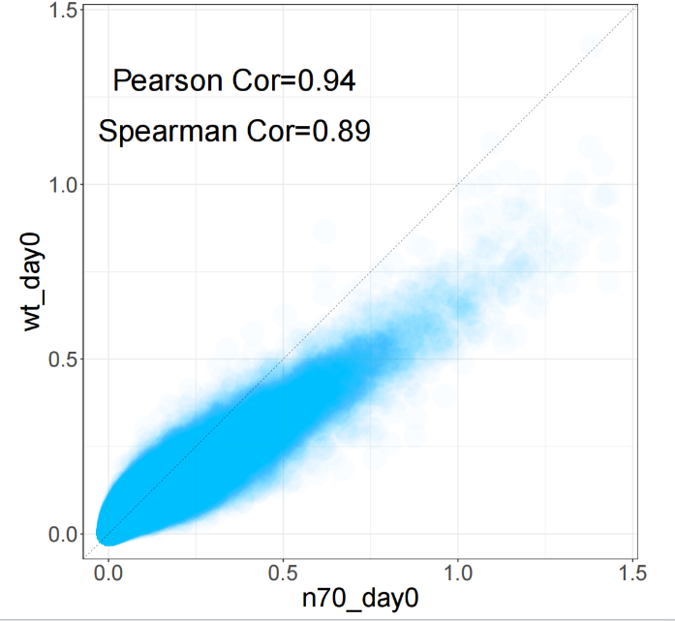
Correlation analysis
- orrelation
Tools：CDesk
Input command line:
CDesk ATAC correlation \
--bw_file1 /mnt/linzejie/CDesk_test/data/3.ATAC/7.Correlation/n70_day0.bw \
--bw_file2 /mnt/linzejie/CDesk_test/data/3.ATAC/7.Correlation/wt_day0.bw \
-o /mnt/linzejie/CDesk_test/result/3.ATAC/7.Correlation/region \
-t 40 --region /mnt/linzejie/CDesk_test/data/3.ATAC/7.Correlation/mm10.2kpromotoer.bed
Typical Parameter:
参数 | 描述 | 默认值
--bw_file1√ | 第一个bw文件 | -
--bw_file2√ | 第二个bw文件 | -
-o√ | 存放输出结果的位置 | -
--region | 指定区域bed文件
-t | 进程数 | 30

